Slide 1
投資人說明會
Institutional Investors
今國光學工業股份有限公司
Kinko Optical CO.,Ltd / 股票代碼: 6209
25th Nov. 2025

Slide 2
06
Kinko's Milestones
Future Development Initiatives
01
04
Content
02
Operational Results
05
Appendix
03
Revenue by Product Category and Contribution Share

Slide 3
Disclaimer
The information contained in this presentation, including all forward-looking information, it subjects to change without notice, whether as a result of new updates, further events or otherwise, and Kinko Optical Co., Ltd undertakes no obligation to publicly update or revise the information contained in this presentation.
Investors should not regard the above forward-looking information as legally binding but as information subject to change. No guarantees regarding the completeness, accuracy, and reliability of information contained are made explicitly or implicitly. They are not intended to represent complete statement of the Company, industry or future development.

Slide 4

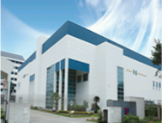
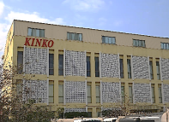
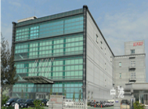
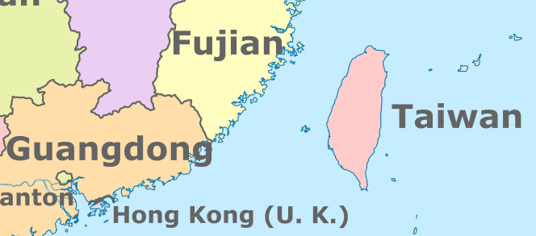
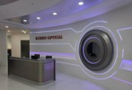
Kinko's Milestones
📍 1980 — Kinko Established
Kinko Optical Co., Ltd. was established in Wuchi District, Taichung City.
Foshan Huaguo (China) operation.
Zhubei Tai-Yuan Science Park – AR waveguide lenses and optical engine R&D center.
📍 1980 – 2010： The Era of Explosive Growth in Digital Camera Lenses
Focused on digital camera lens grinding and polishing technologies
Established a complete optical lens manufacturing process and quality management system
Laid the foundation for global optical supply chain partnerships
— Represented by collaborations with PREMIER and CANON
📍 2005 – 2030： Strategic Transition to Lens Design and Manufacturing
Established a mold factory, plastic injection-molding technologies, and automated assembly lines
— Transforming into a comprehensive optical lens solution provider
Expanded product portfolio
— Automotive lenses
— IoT imaging lenses
Full-spectrum product offerings
— Expanded from visible-light lenses to long-wave infrared (LWIR) thermal imaging lenses
(applications: drones, optical sights, temperature-measurement devices, smartphone add-on lens)
Guangdong, China
Kinko Optical H.Q
Chungkang Branch
Hsinchu Branch
AR Smart Glass Develop

Slide 5
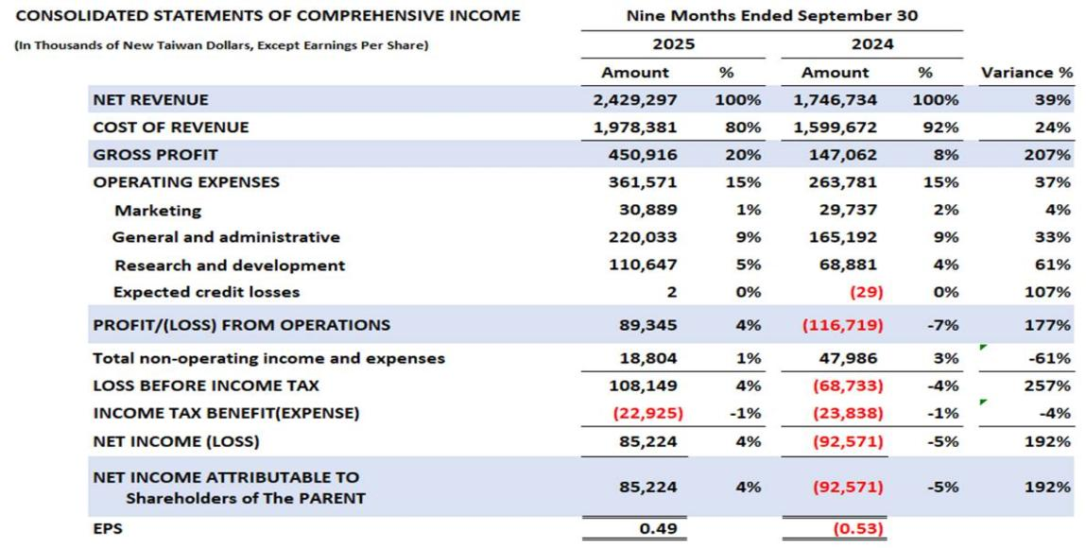
Operational Results (Year-over-Year Comparison )

Slide 6
Gross Margin
Unit ：%
Gross Margin
Notes:
營業毛利 2025Q1單季 為11.1%、2025Q2單季 為20.5%、2025Q3單季 為23.4%
營業淨利率到2025Q3單季 已提升至 7 % ，2025年截至9月已提升至4%

Slide 7
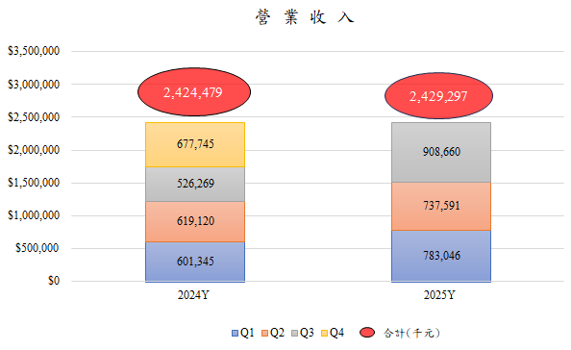
Revenue
Revenue
Unit: Thousand New Taiwan Dollars (NT$ ‘000)

Slide 8
Revenue by Product Category and Contribution (%)
Unit: Thousand New Taiwan Dollars (NT$ ‘000); %
2025Y
1~9M
2024Y

Slide 9
Future Development Initiatives
1. Continue developing high-end visible-light lenses (wavelength 350 nm–750 nm)
IoT lenses
Automotive lenses
Drone lenses
2. Continue expanding long-wave infrared (LWIR) lenses (wavelength 8 µm–14 µm)
Drone lenses
Optical sight lenses
Automotive lenses
Temperature-measurement lenses

Slide 10
Future Development Initiatives
3. Actively develop products for AR/VR/MR applications
Waveguide lenses
Optical engines
Pancake lenses
Freeform lenses
Meta lenses
4. Develop products for LEO satellite applications
Reflective optical devices
RGB lenses

Slide 11
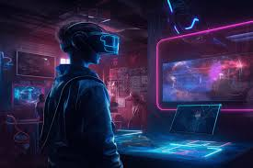
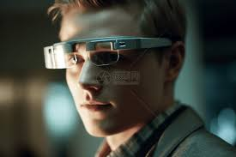
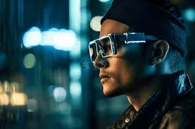
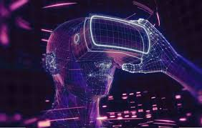
Appendix – Optical Products for AR/VR/XR

Slide 12
Kinko AR/VR/MR Capability
Angus Wu Ph.D
2025/11/25

Slide 13

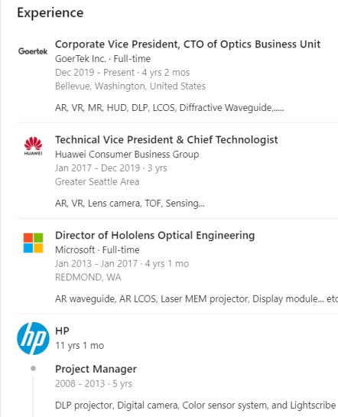
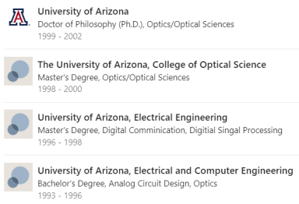

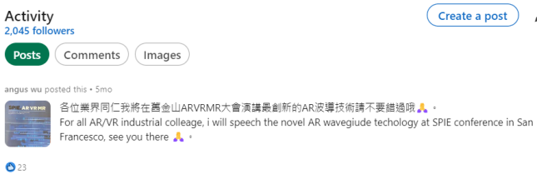
All my life has been working on Optics products….
I worked on AR smart glasses since 2012….
Valedictorian of Ph.D class
52 US patents awarded

Slide 14
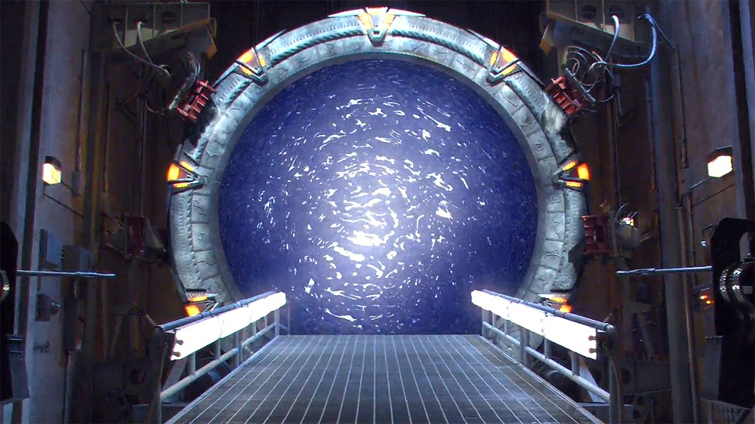
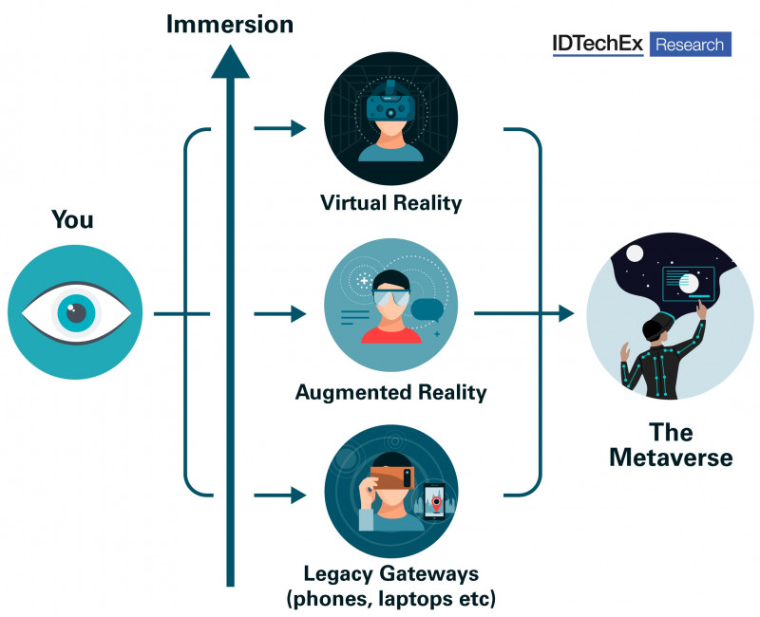
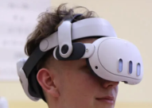
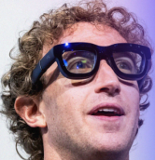
Current
Future
The gateways
to the metaverse:
AR VR MR?
The Past

Slide 15
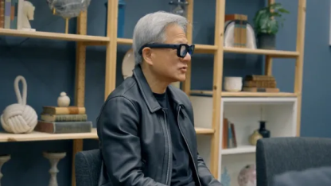
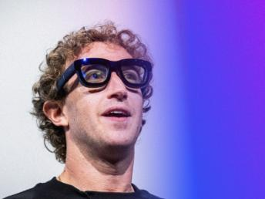
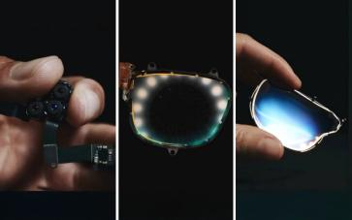
AR smart glasses is the future platform for AI
Two richest men in the world wants AR smart glasses
Lightweight, Slim, Fashionable, Prescription able, long battery life, like eye-glasses

Slide 16
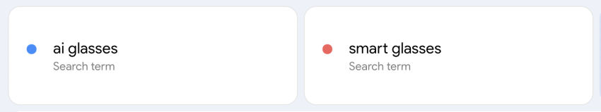
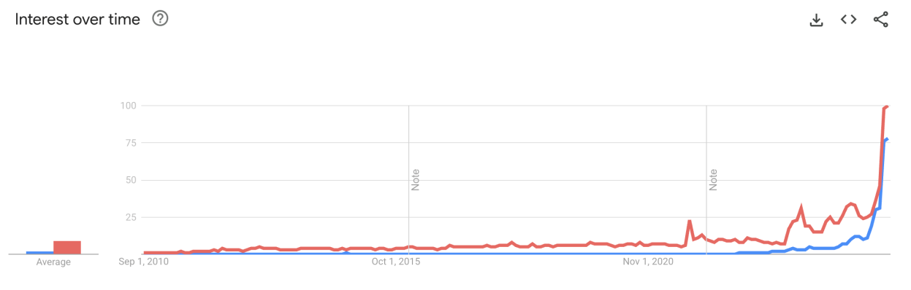
We are living in the most exciting times for smart glasses
Google trends for “AI glasses” and “Smart Glasses” over the past 15 years
Today
10/17/2023
Ray Ban Meta
09/09/2021
Ray Ban stories
Google Glass
2012

Slide 17
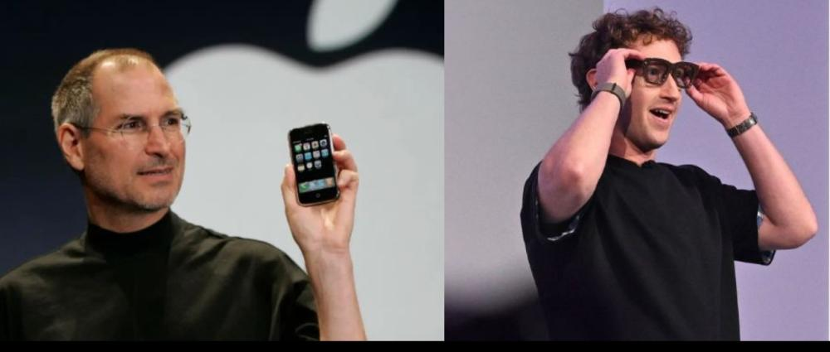
Is the world ready today for an alternative to the smart phone introduced 20 years ago?
… not really… but smart glasses can provide user experiences a smart phone can’t…
… and you don’t need to pull your phone out of your pocket that often anymore ….

Slide 18
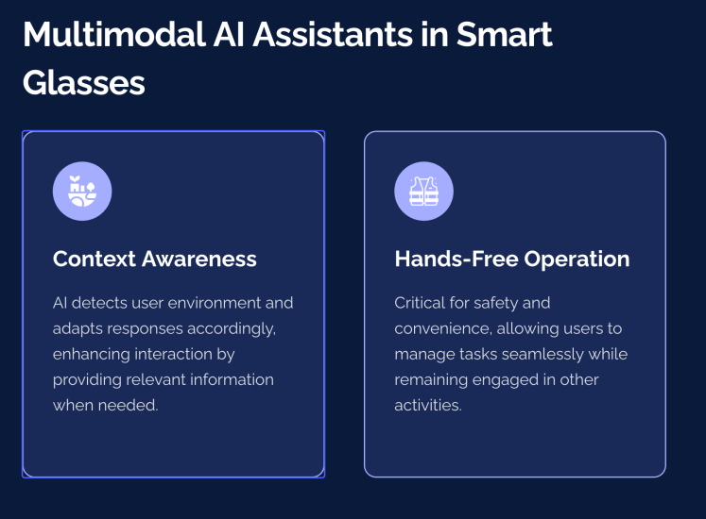
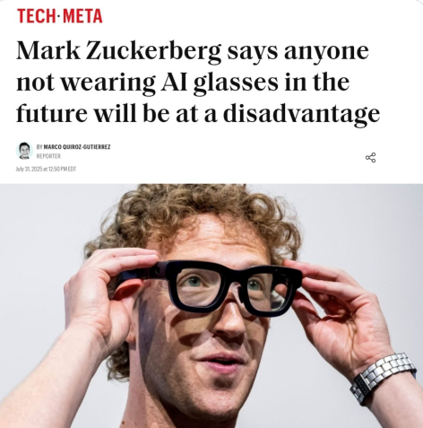

Slide 19
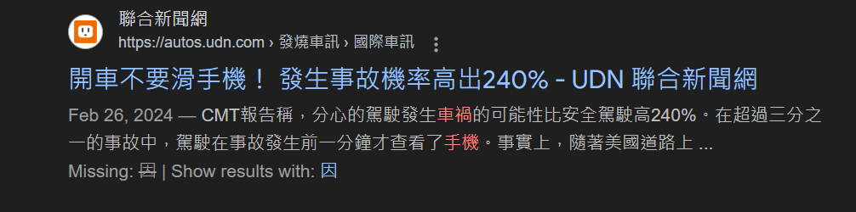
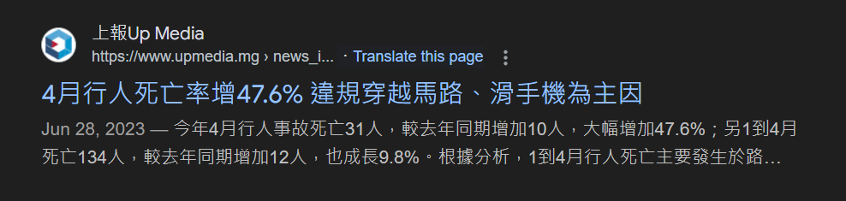
Car accident

Slide 20

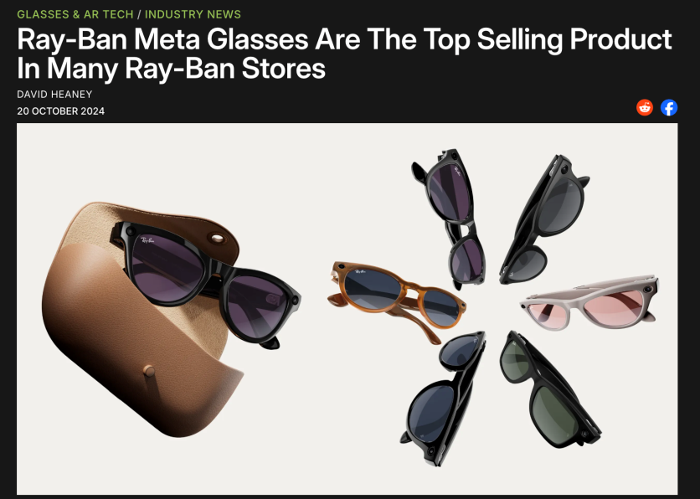
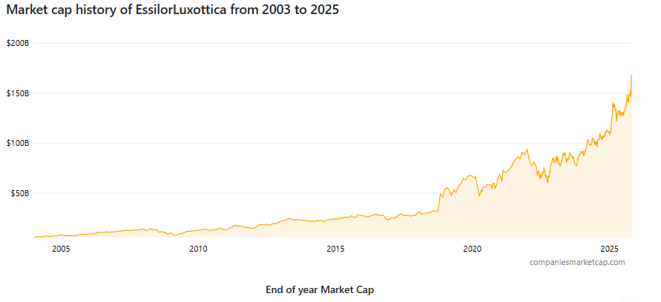
Audio AI eyewear reached already a strong echo with consumers
Ray Ban Display
Ray Ban Meta
Ray Ban Stories
This revelation comes from Essilor-Luxottica’s CFO Stefano Grassi on the company’s Q3 2024 earnings call.

Slide 21
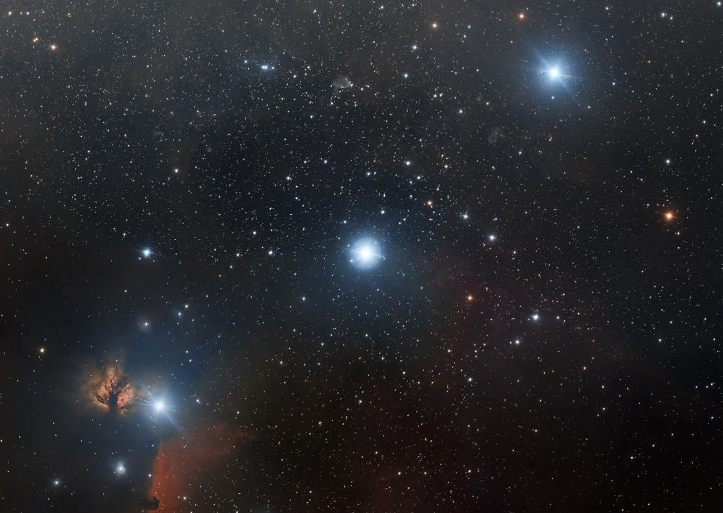
Today (2025), we have finally all 3 stars aligned
AI powered
use cases
(Gemini/Astra, Apple Intelligence, Meta AI…)
Generic platform
(Android XR, Vision OS, Horizon OS, Snap OS …)
AR Hardware Ecosystem
(light engine, waveguide, sensors, compute,comms, …)

Slide 22
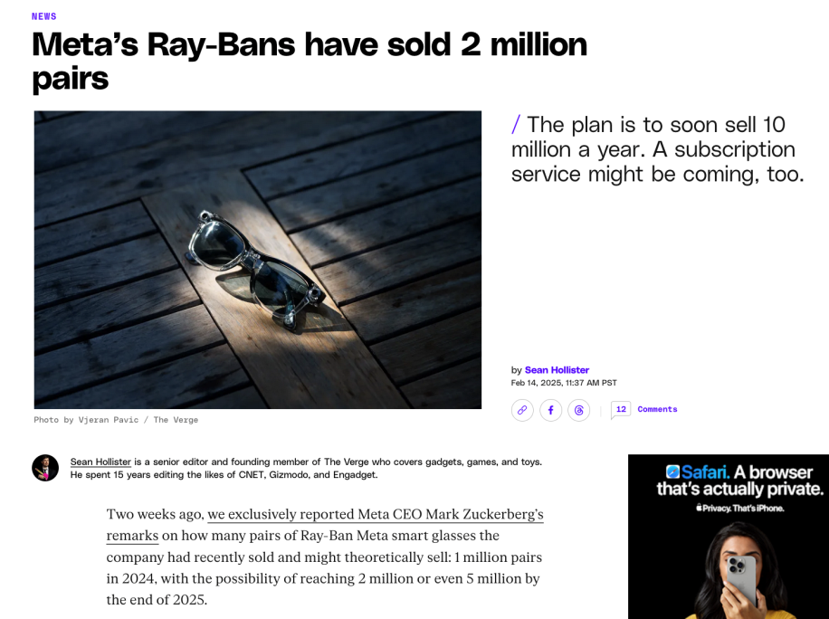
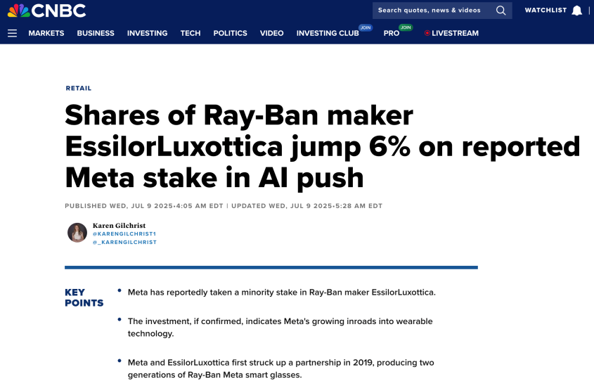

Slide 23
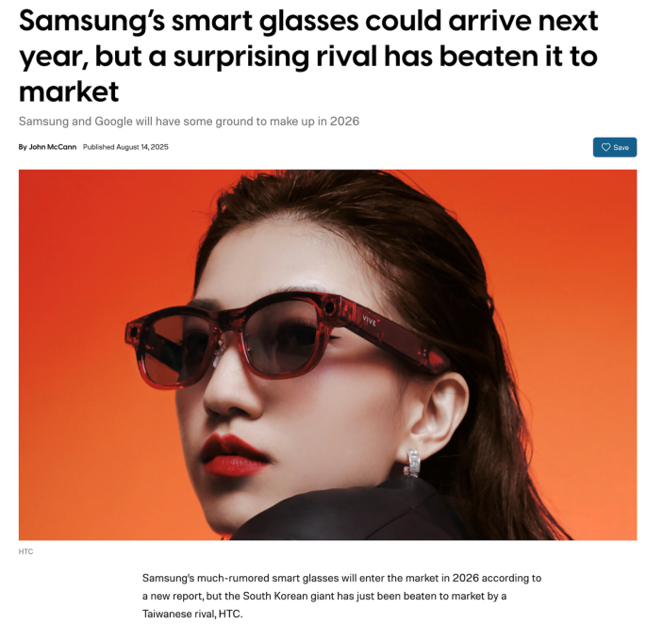
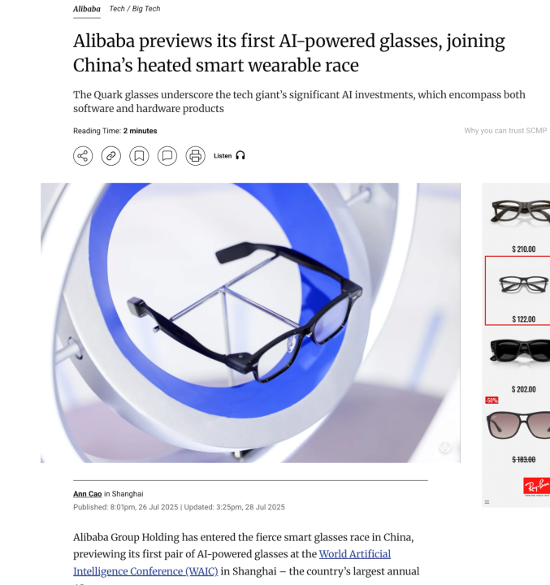
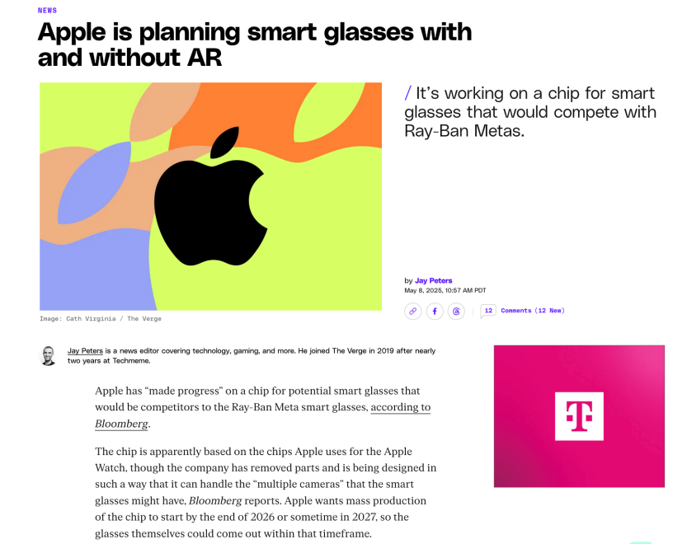
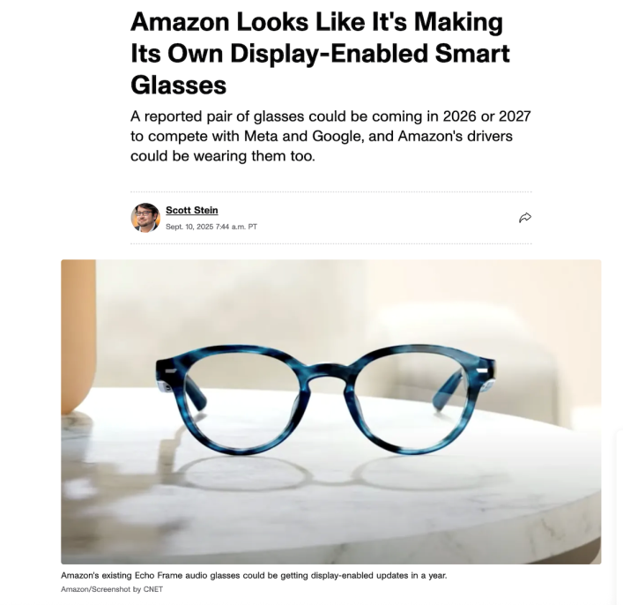
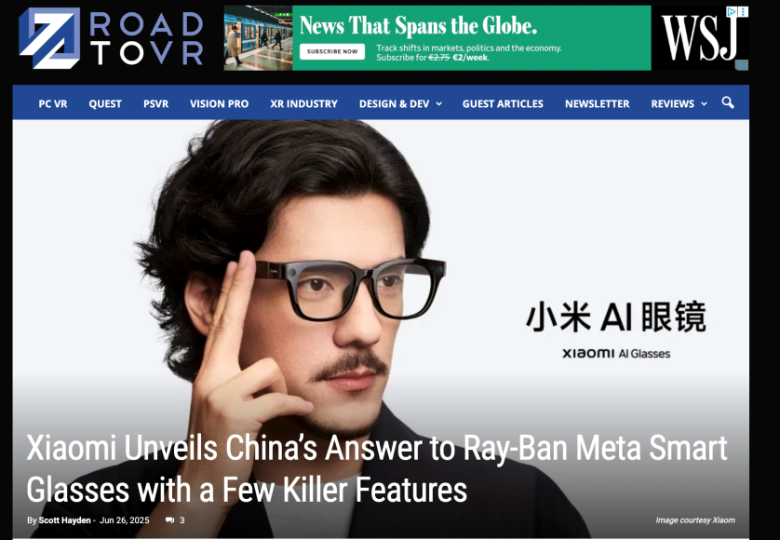
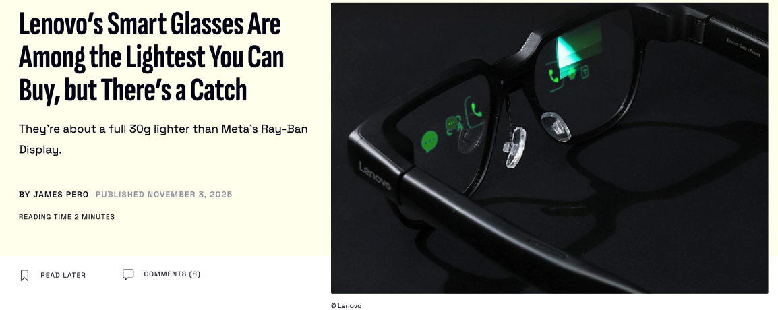
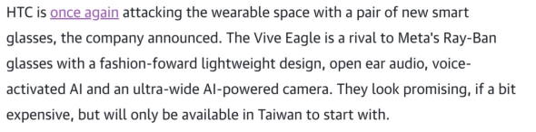

Slide 24
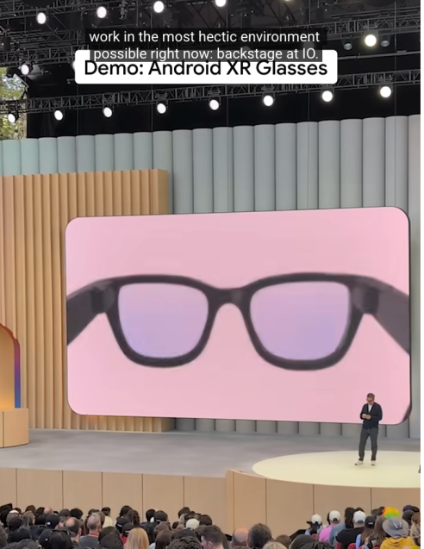
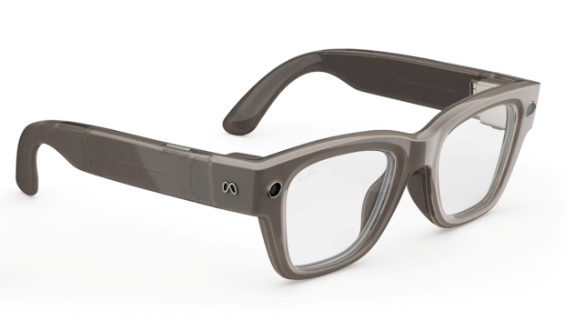
MicroLED based smart glasses 20 deg FOV
LCoS based smart glasses 20 deg FOV
Tapered temples
Straight temples

Slide 25


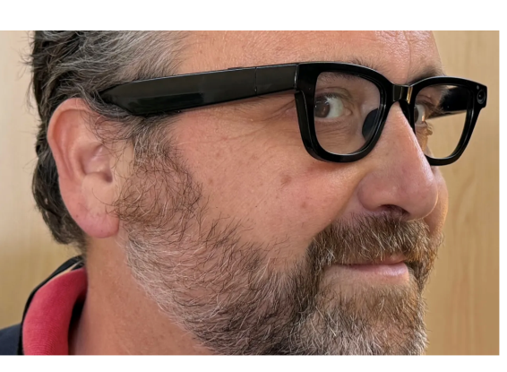
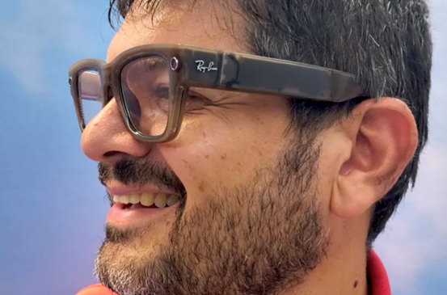


MicroLED based smart glasses 20 deg FOV full color
LCoS based smart glasses 20 deg FOV full color

Slide 26
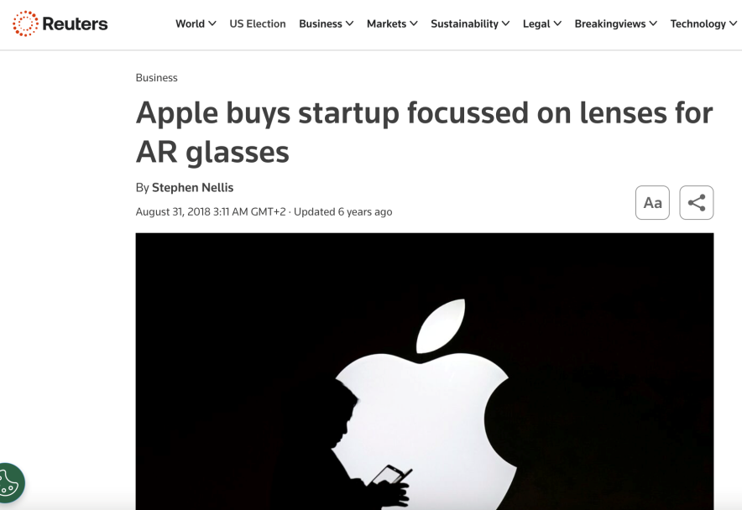
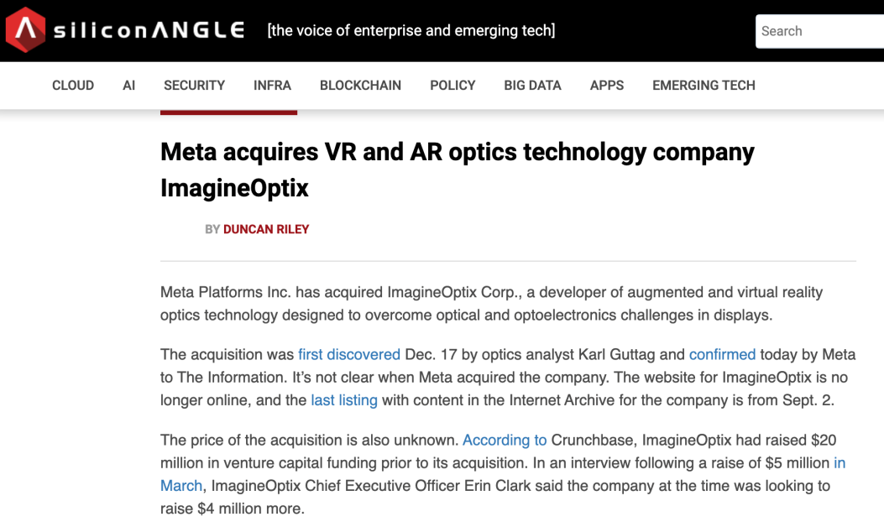
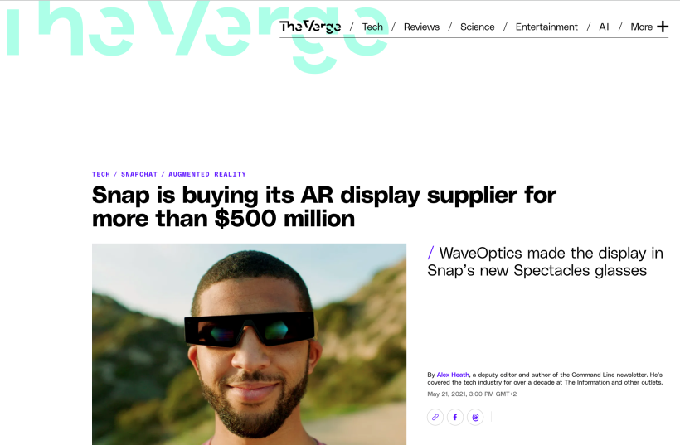
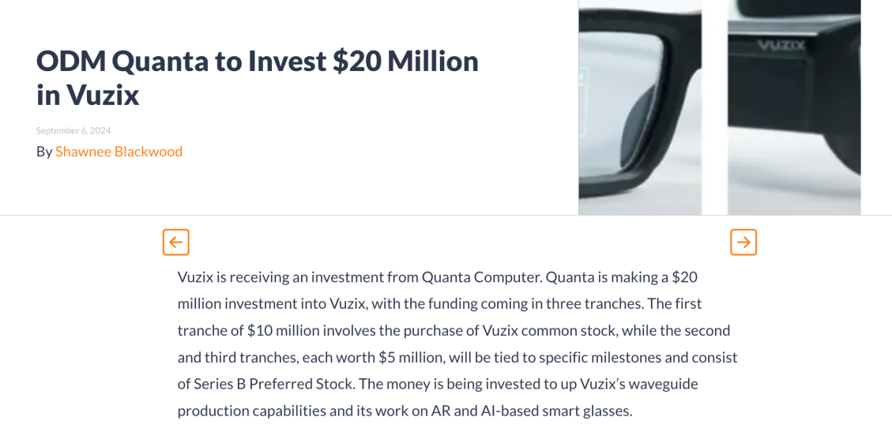
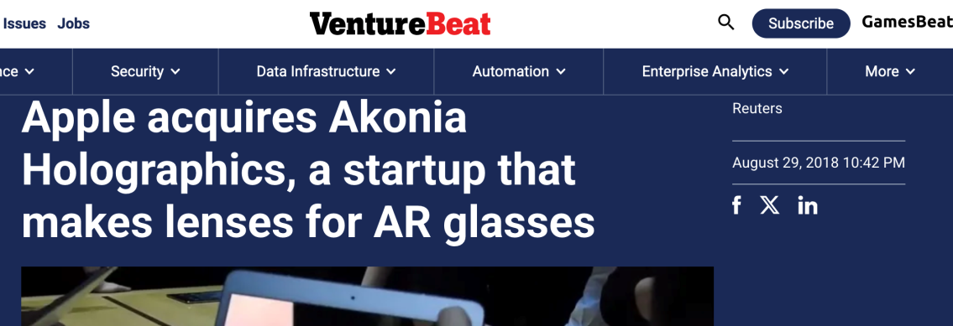

Slide 27
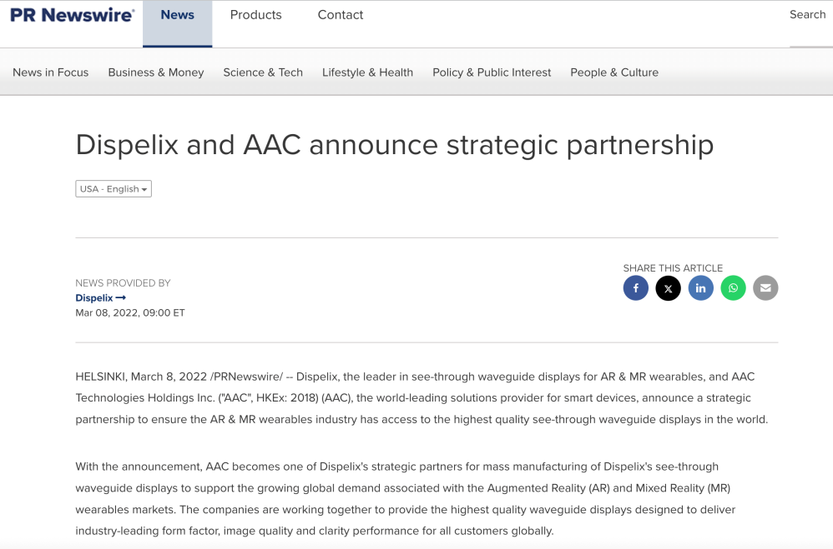

Slide 28



Slide 29



Slide 30





Meta Orion AI smart glasses (Optics>65%) 2025
Micro-LED Light Engine
SiC carbide waveguide (n=2.6)
7 cameras
Eye tracking
Hand tracking
Whist band
Magnesium frame
Wi-Fi power bunk

Slide 31




Android XR

Slide 32







Kinko XR-smart glasses business strategy (Key components)
Light engine
Waveguide
Display module
Smart glasses integration (Demo)
AI integration (Demo)

Slide 33

XR Smart Glasses (元宇宙)
真實的世界場景
虛像加入真實的場景
衍射光學波導
光機
人眼

Slide 34


Building the XR ecosystem involves multi-tier companies:
Tier 1 suppliers (Display assembly and sensing assembly modules, Rx procurement…)
Tier 2 suppliers (waveguide combiners, micro display panels, IR cameras,…)
Tier 3 suppliers (NIL resins, HRI substrates, QDs for LED color conversion, process developments and production equipment, …)

Slide 35
Waveguide Technology

Slide 36







Waveguide combiners classification
Diffractive (SRG)
Holographic (VBG)
Geometric 1D EPE
Geometric 2D EPE
NA
HoloLens 1
3 plates
ML1 / ML2
Digilens MotoHud
Interesting developments
HoloLens 2
2 plates
Vuzix
WO
Interesting developments
Digilens Crystal 30 and 50
Sony
Apple
Lumus DK50
Lumus Maximus
Single plate
glass
Dispelix / AMAT/
Meta Orion/
Digilens SRG+
Single plate plastic
Oppo, Cellid
Digilens (hybrid plastic/glass)
Optinvent
ORA1
Concepts and patents
Single plate curved
ML
Zeiss Tooz smart glass (no EPE)
Concepts and patents

Slide 37

Meta Orion glasses (META Connect 2024): SiC waveguides ($$$!)

Slide 38






SRG+ Waveguides technology
Slanted and Tall Aspect Ratio >10:1
Slant / Trapezoidal Angle Control
NO RESIDUAL LAYER
Duty Cycle Control (<20%)
Smooth surface and volume profiles

Slide 39








Kinko NIL imprinting Technology
12” wafer
8” wafer

Slide 40
Mini-Projector Technology

Slide 41



Light Engine
The light engine only 1 cc contain over 25 components
> +/- 10um optical precision is needed
Customized high precision assembly is needed
High thermal conduction design to meet optical specifications
1 cc

Slide 42
AR smart glasses R & D location
R&D/MP
Taichung
R & D
HsinChu
Establish Hsinchu site to recruit all experts
Hsinchu and Taichung R&D site for fast prototypes
Taichung HQ will be the main MP site
Easy tech transfer to MP site (within one hour drive)
South Asia and North America for assembly site
South Asia / North America
US customer Prefer to
have NPI line in CA

Slide 43













Roadmap (Meta, Google, Apple, Samsung, SNAP, Amazon…etc.)
Smart Glasses
Kinko
2025
2012
2022
2025/2026
2027
2028
2030
2035
Gen 1
Gen 2
Ref 1
Ref 2
Ref 3
Gen 1
Gen 2

Slide 44
Conclusion
High technical challenge mainly in Optics
Slim, Lightweight, Eyeglasses like, Low cost
Smart glasses will be platform for AI
XR Smart glasses enable AI and hand free
Apple-IOS, Google-Android XR, Meta-Horizon, Huawei-Harmony
2027-2028 Meta, Samsung, Apple launch XR smart glasses
2029-2030 2nd generation XR smart glasses
The smart glasses will be the next big thing to replace smartphone
Some are happy and some are sad 幾家歡樂, 幾家愁

Slide 45

Kinko has all AR Smart Glasses technologies
Everything made in Taiwan (MIT)

Slide 46
Thank You
Angus.wu@kinko-optical.com

