Slide 1
Institutional Investors
Kinko Optical CO.,Ltd / Stock code: 6209
20th Nov. 2024

Slide 2
Disclaimer
06
Product Ratio By Revenue
01
Company Profile
Financial Report
02
07
Content
Kinko's Milestones
AR smart glasses is the future platform for AI
03
08
Core Product Line
AR smart glasses market size
04
09
Future Core Product
Major Players & Kinko Opportunity
05
10

Slide 3
Disclaimer
The information contained in this presentation, including all forward-looking information, it subjects to change without notice, whether as a result of new updates, further events or otherwise, and Kinko Optical Co., Ltd undertakes no obligation to publicly update or revise the information contained in this presentation.
Investors should not regard the above forward-looking information as legally binding but as information subject to change. No guarantees regarding the completeness, accuracy, and reliability of information contained are made explicitly or implicitly. They are not intended to represent complete statement of the Company, industry or future development.

Slide 4
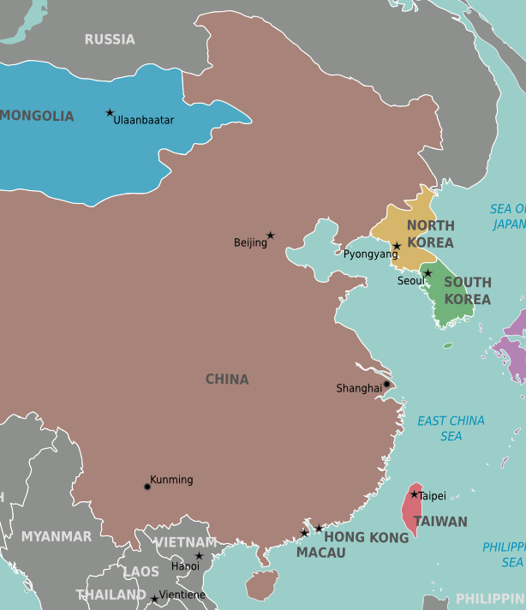

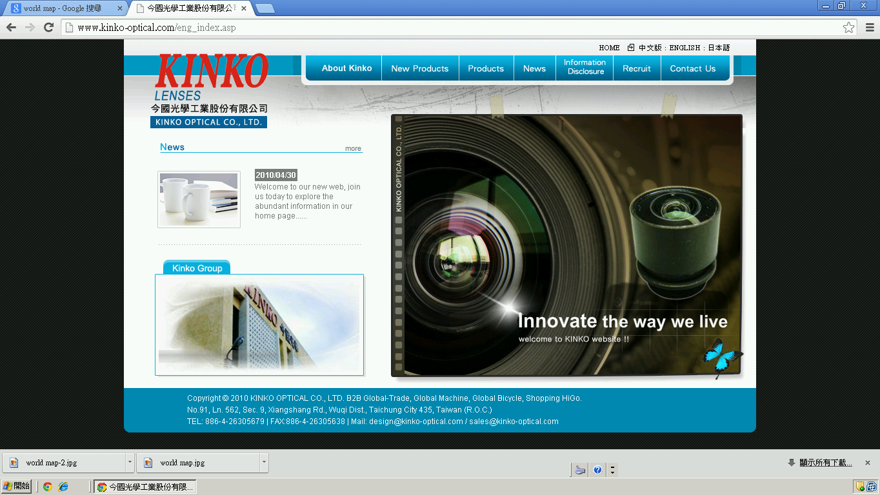
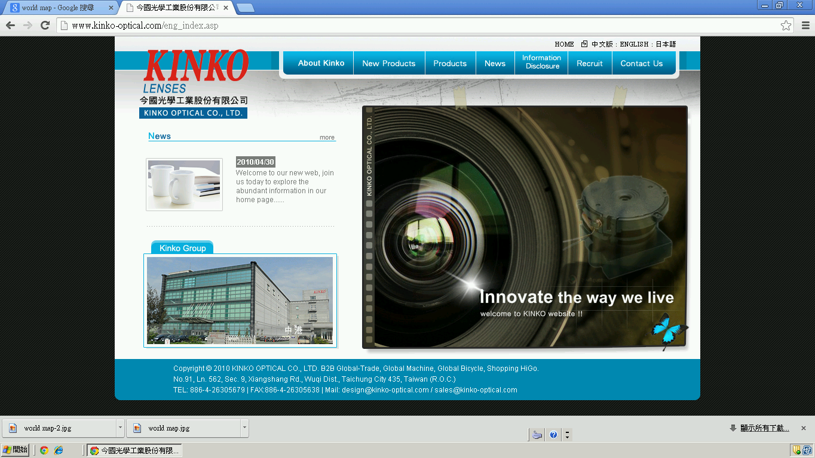
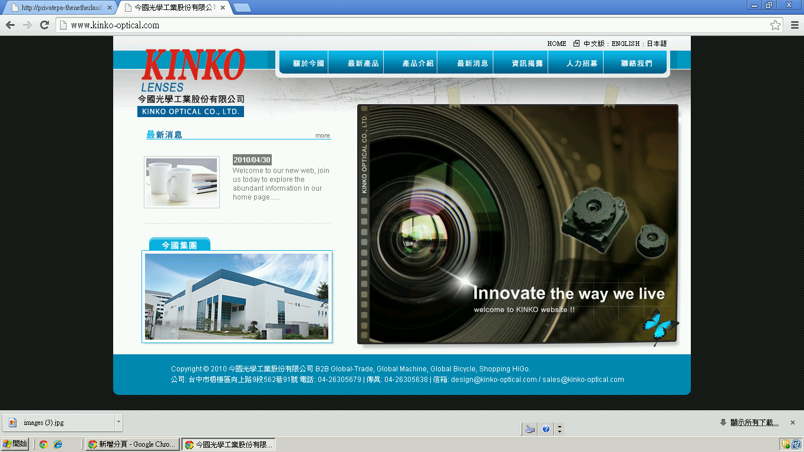
Company Profile
KINKO Optical
H.Q.
今國光學工業股份有限公司
Kinko Optical CO., Ltd
Established:19th June 1980
Founder/C.E.O.
Mr. Chen, Ching-Chi (Kent)
GM:Mr. Chen, Yi-Fang (Jason)
Registered capital:Approx: NTD 1.74 Billion
Main business units:
Glass Lens / Molding Glass Lens /
Lens units /Optical Lens design & manufacture
Numbers of Employee:1,698 people
H.Q.:Kinko Optical (Taichung Taiwan)
Factories:
Kinko Optical (Taichung Taiwan)
Foshan HuaGuo (GuangDong China)
Polished Glass
KINKO Optical
Chung Kang Branch
Molding Glass, Plastic Lens, Lens Assembly
Foshan Huaguo
GuangDong, China
Polished glass, Far infrared lens units

Slide 5
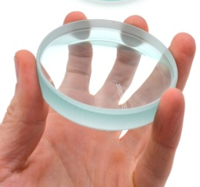

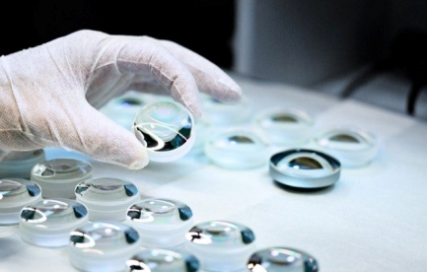
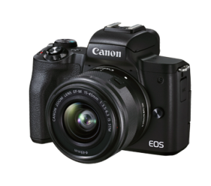
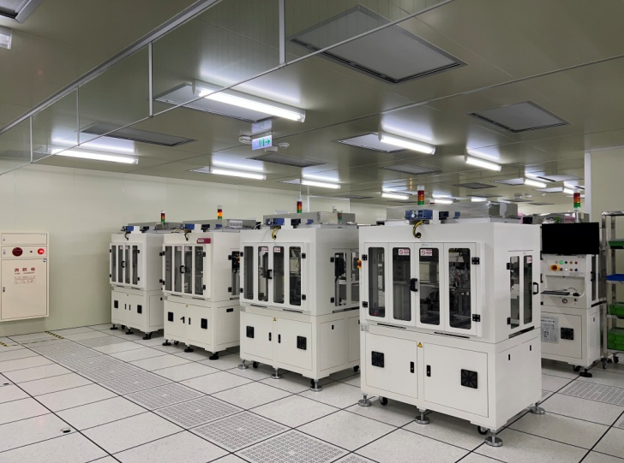
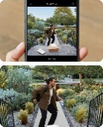
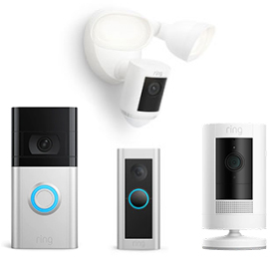
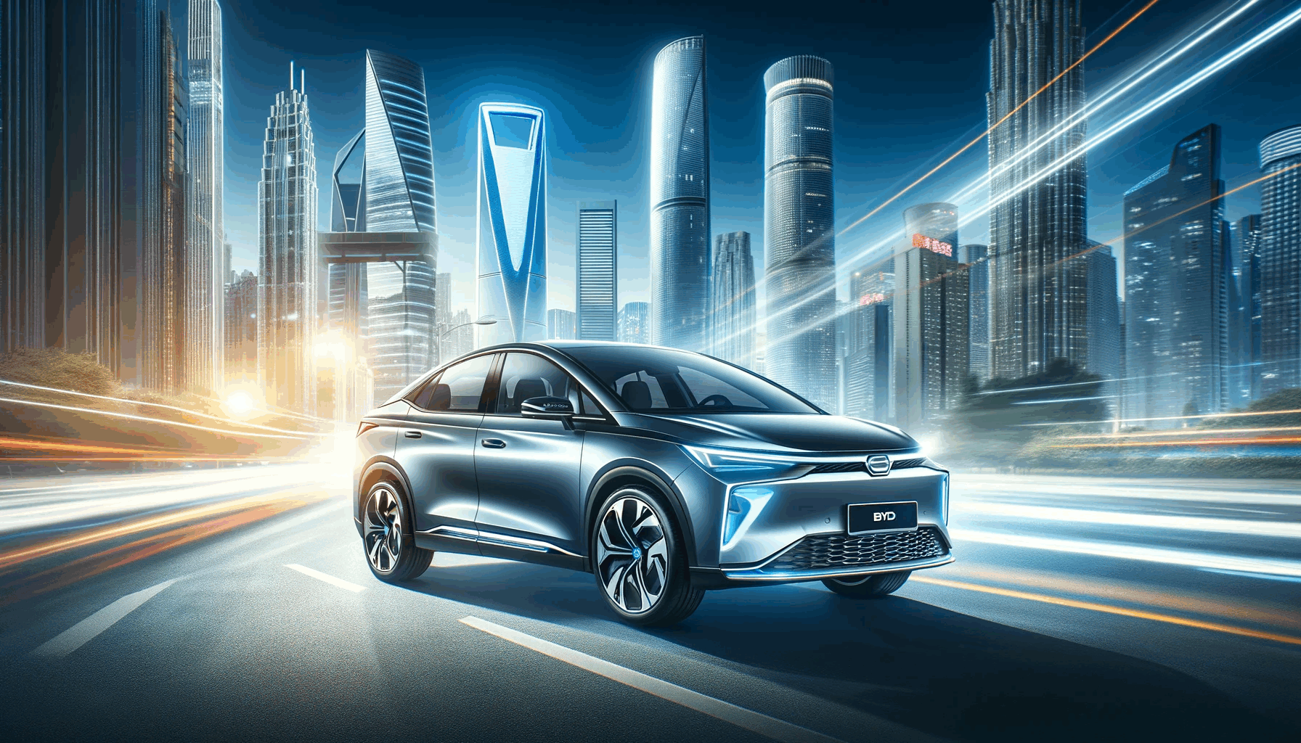
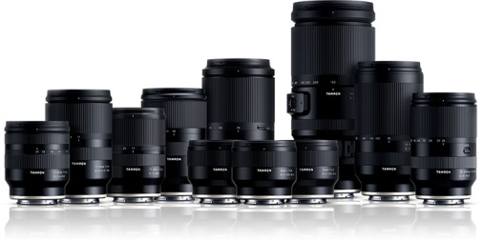
Kinko's Milestones
Entered the U.S. IoT brand supply chain, supplying smart doorbell lenses and smart speaker lenses.
Successfully entered the automotive Tier 1 supply chain, supplying a wide range of automotive lenses for imaging/ADAS/ LiDAR/thermal imaging.
Continuing to develop the thermal imaging lens market
Expanded production base and established Foshan HuaGuo branch
Expanded product business groups; introduced automated assembly lines at the Chung Kang Branch
Co-operate with international camera brands to ride on the growing trend of D-SLR cameras
KINKO was established in Taichung, Taiwan
1980
1992
1997
2012
2018~2024

Slide 6
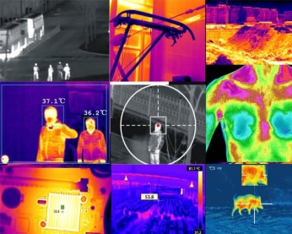




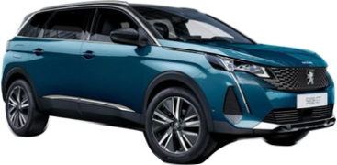



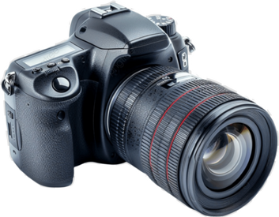
Core Product Line
Thermal Lens
01
Vehicle, Drone, Surveillance, Industrial
Automotive Lens
02
ADAS, LiDAR, autonomous driving, in-vehicle and out-of-vehicle monitoring, car recording
Made in Taiwan
IoT Lens
03
Smart Doorbell, Home Monitoring, Smart Office, Smart Speaker
D-SLR Lens
04
D-SLR Large Diameter Lens

Slide 7

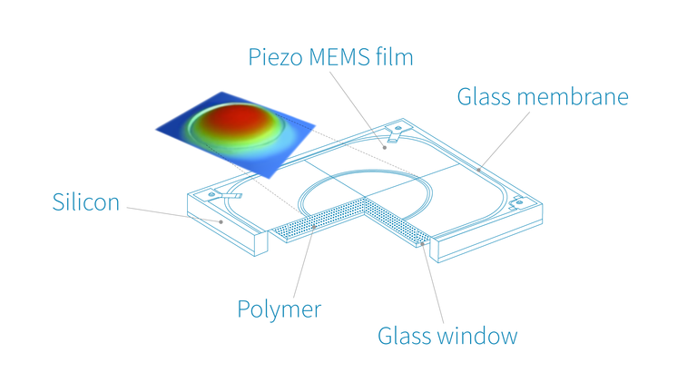
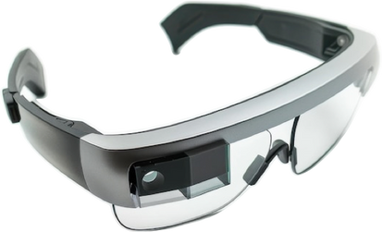
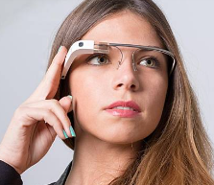
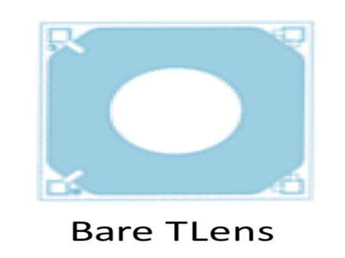
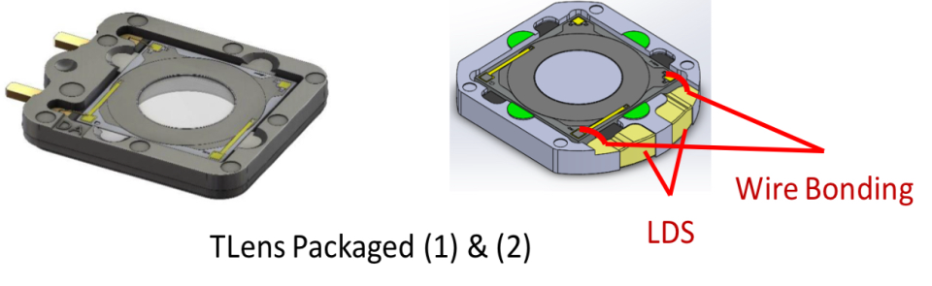
Future Core Product
AR &VR
T Lens

Slide 8
Product Ratio By Revenue
 | Y2022 | Y2023 | Y2024 Jan~Sep
LWIR Lens | 17.05% | 13.30% | 24.20%
Automotive/Lens Element | 9.42% | 10.60% | 13.90%
D-SLR Large Diameter Lens | 29.35% | 23.70% | 23.40%
IoT | 32.59% | 37.60% | 24.00%
Other (Industrial Lens 3.7% & Projection Lens 4%) | 11.59% | 14.80% | 14.50%

Slide 9
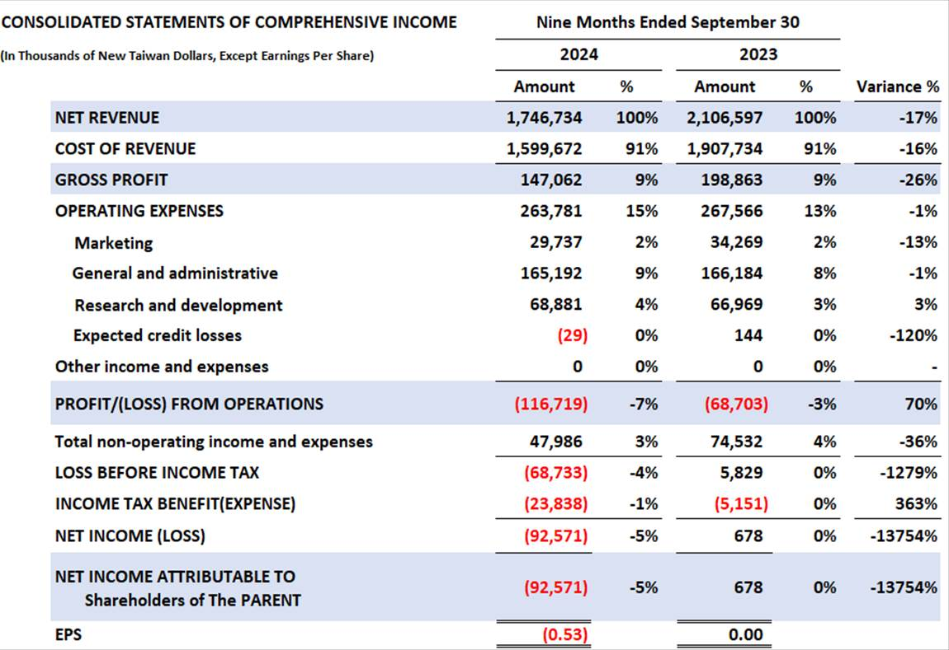
Financial Report (Yearly Comparison)

Slide 10
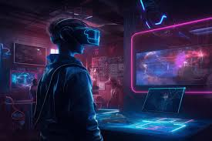
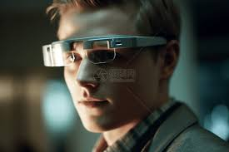
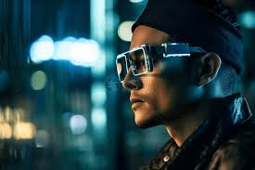
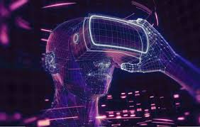
Appendix

Slide 11
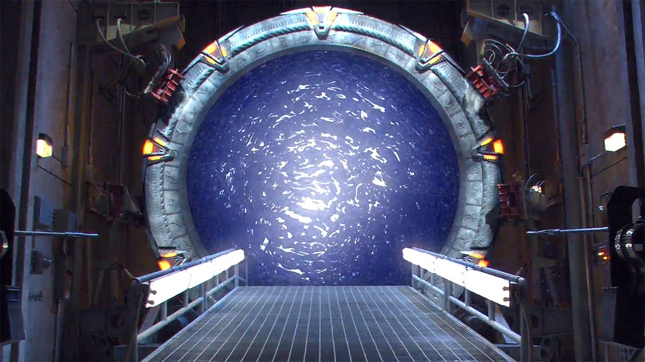
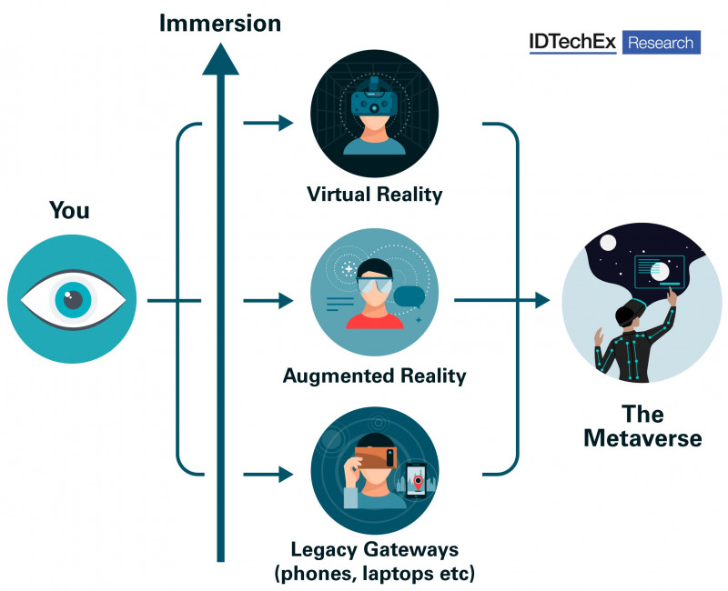
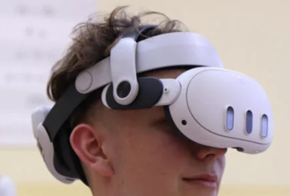
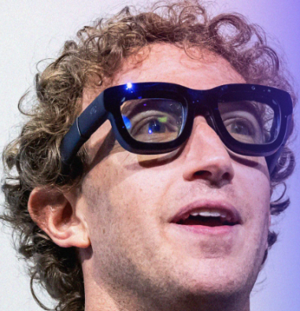
The gateways
to the metaverse:
AR VR MR?

Slide 12
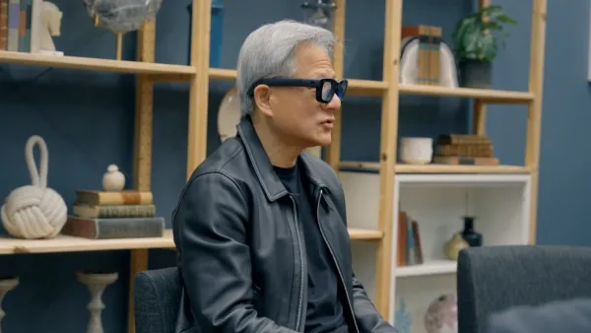
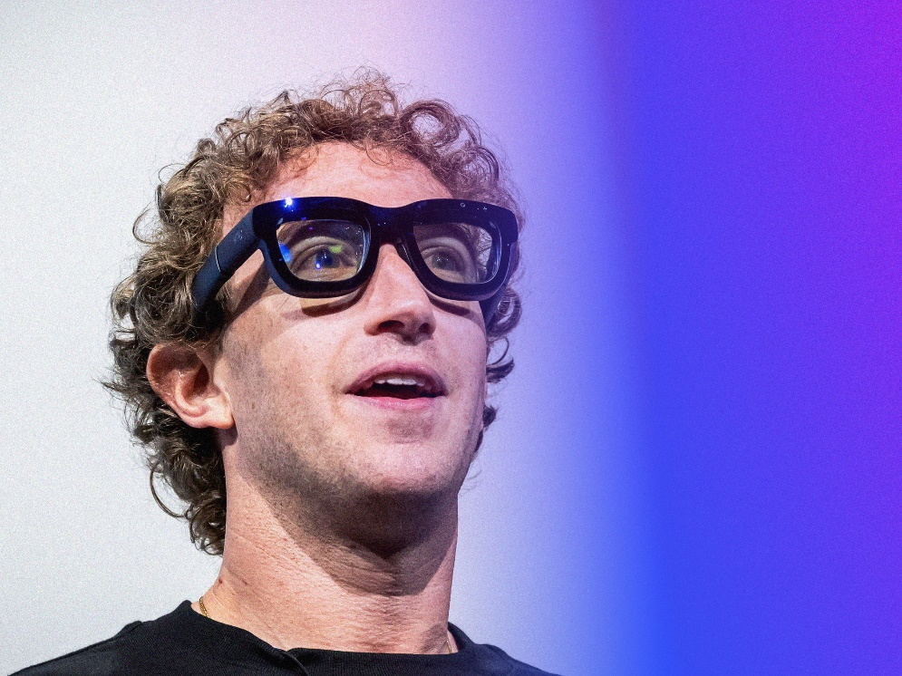
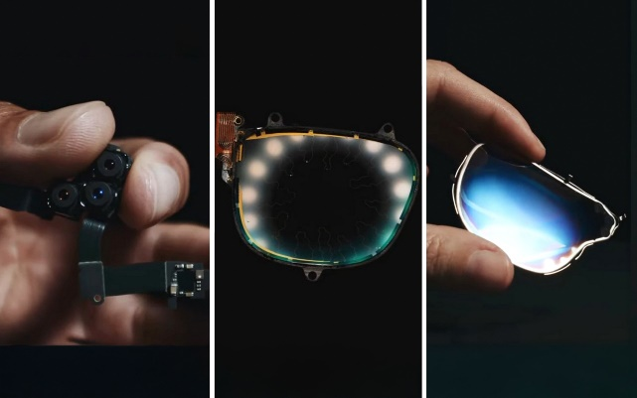
AR smart glasses is the future platform for AI
Two richest men in the world
Lightweight, Slim, Fashionable, Prescription able, long battery life, like eye-glasses

Slide 13
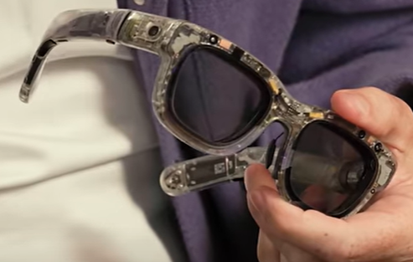
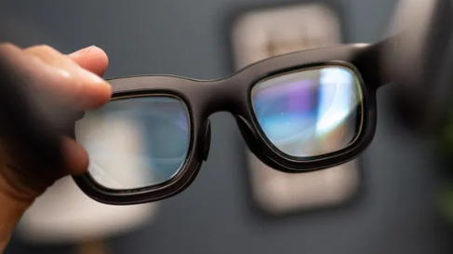
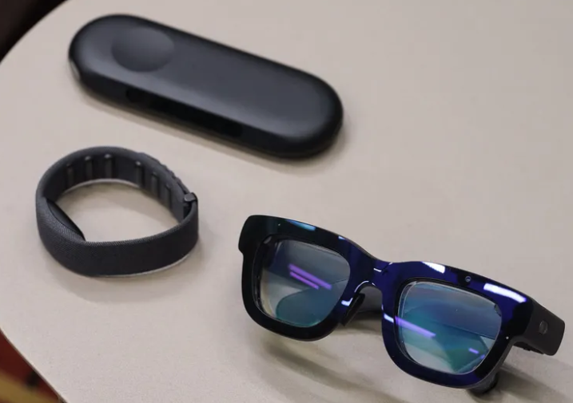
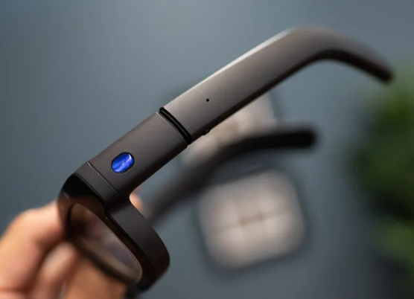
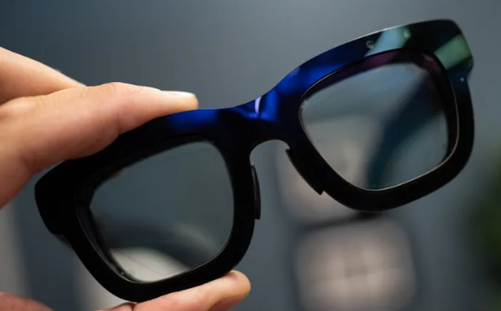
Meta Orion AI smart glasses (Optics>65%)
Micro-LED Light Engine
SiC carbide waveguide (n=2.6)
7 cameras
Eye tracking
Hand tracking
Whist band
Magnesium frame
Wi-Fi power bunk

Slide 14
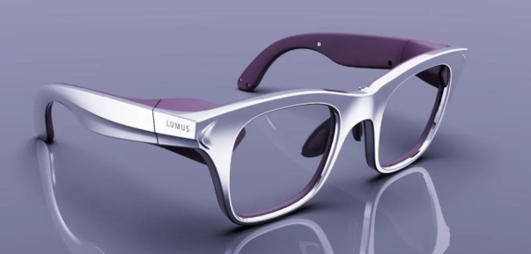
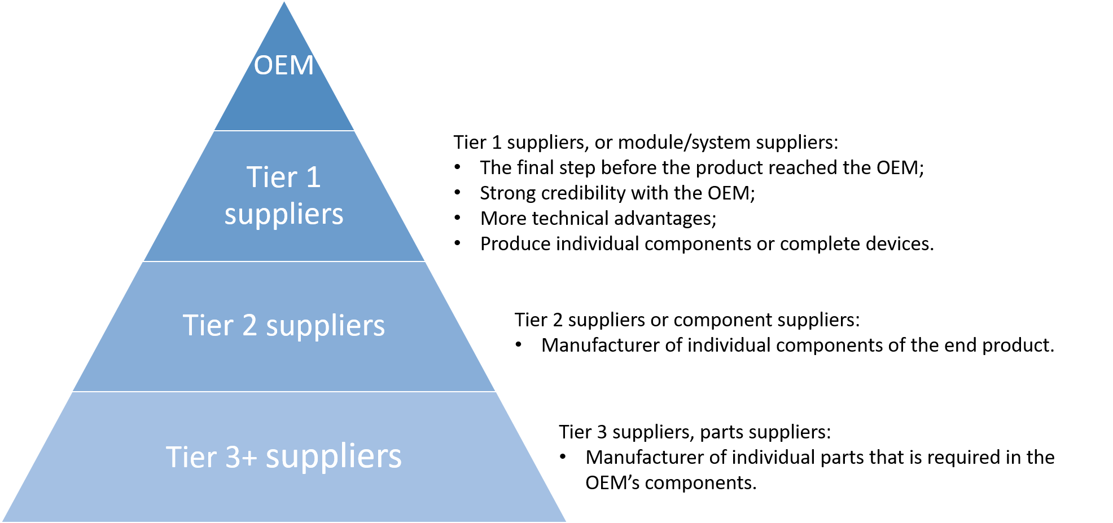
Building the AR ecosystem involves multi-tier companies:
Tier 1 suppliers (Display assembly and sensing assembly modules, Rx procurement…)
Tier 2 suppliers (waveguide combiners, micro display panels, IR cameras,…)
Tier 3 suppliers (NIL resins, HRI substrates, QDs for LED color conversion, process developments and production equipment, …)

Slide 15

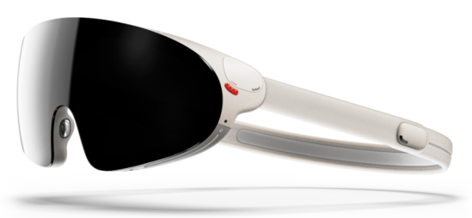
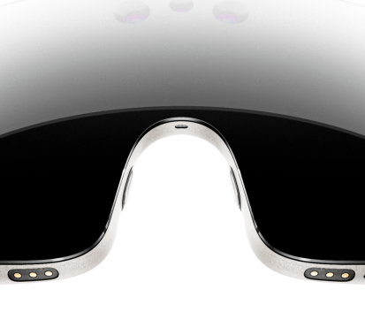
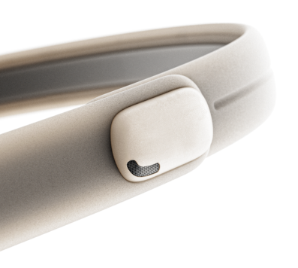
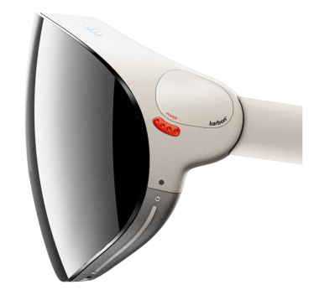
Kinko AR-smart glasses business strategy
Light engine
Waveguide
Smart glasses integration (Demo)
AI integration (Demo)

Slide 16
AR smart glasses market size

Slide 17
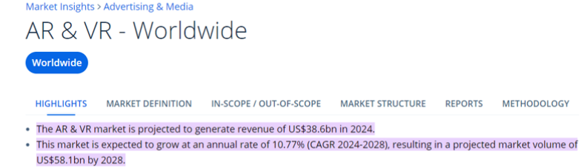
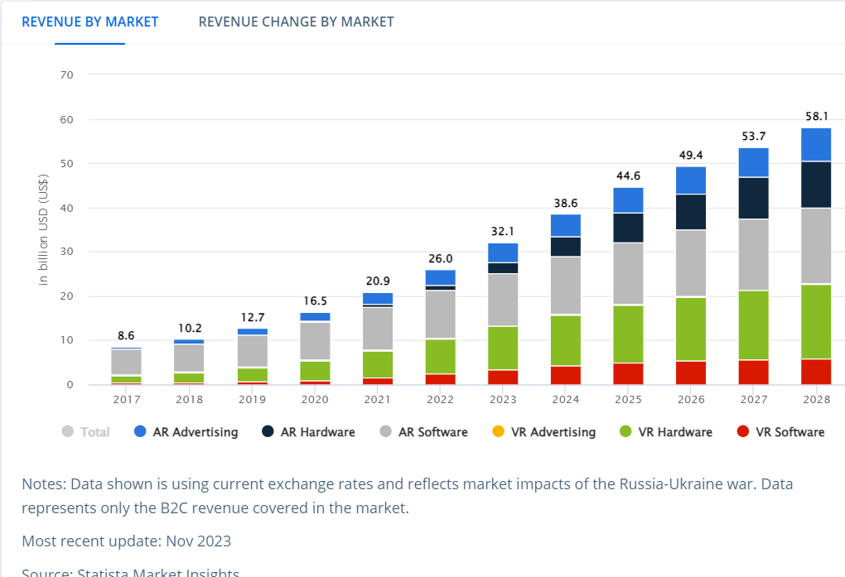
AR VR Market

Slide 18
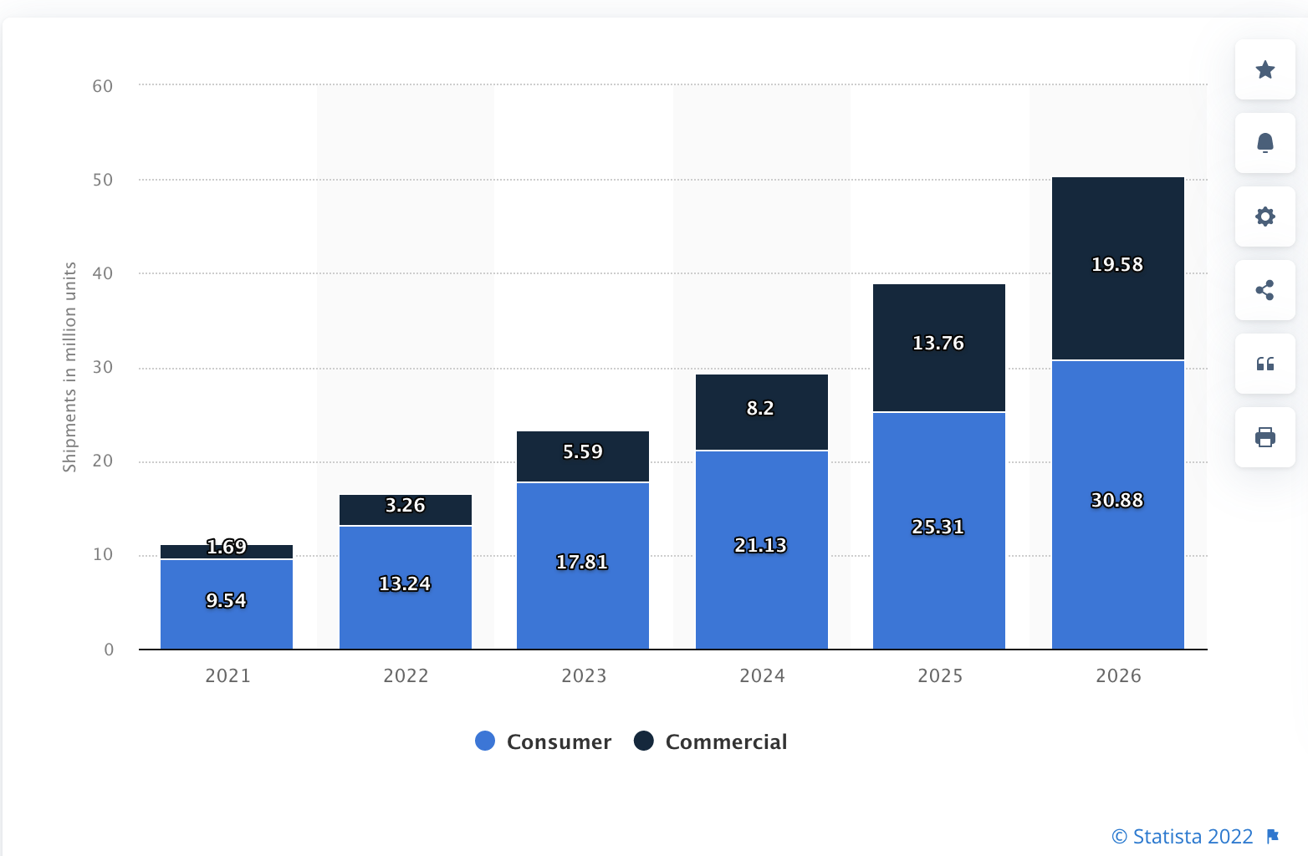
Consumer vs Commercial of AR & VR headset

Slide 19
Major Players & Kinko Opportunity

Slide 20
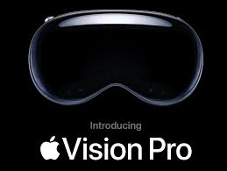

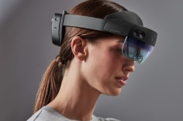


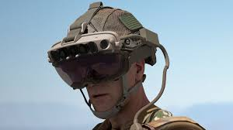
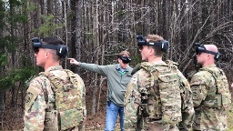





Roadmap (Meta, Apple, Samsung, Amazon…etc.)
Smart Glasses
Kinko
2025
2012
2022
2025/2026
2027
2028
2030
2035
Gen 1
Gen 2
Ref 1
Ref 2
Ref 3
Gen 1
Gen 2

Slide 21

AR Smart Glasses(metaverse)

Slide 22

Waveguide

Slide 23



Light Engine
The light engine only 1 cc contain over 25 components
> +/- 10um optical precision is needed
Customized high precision assembly is needed
High thermal conduction design to meet optical specifications
1 cc

Slide 24

Conclusion
Metaverse AR smart glasses is coming
High technical challenge mainly in Optics
Slim, Lightweight, Eyeglasses like, Low cost
Smart glasses will be platform for AI
Smart glasses enable AI and hand free
Apple-IOS, Google-Android XR, Meta-Horizon, Huawei-Harmony
2027-2028 Meta, Samsung, Apple launch AR smart glasses
2029-2030 2nd generation AR smart glasses
The smart glasses will be the next big thing to replace smartphone
Some are happy and some are sad 幾家歡樂, 幾家愁

Slide 25
Thank you for listening~

