Slide 1
Institutional Investors
今國光學工業股份有限公司
Kinko Optical CO.,Ltd / Stock Number: 6209
16th Nov. 2023

Slide 2
Disclaimer
06
Infrared Thermal Imaging Lens
01
Company Profile
Product Ratio By Revenue
02
07
Content
Company Strength
Financial Report
03
08
Product Development
Kinko Vision
04
09
05
IOT Lens

Slide 3
Disclaimer
The information contained in this presentation, including all forward-looking information, it subjects to change without notice, whether as a result of new updates, further events or otherwise, and Kinko Optical Co., Ltd undertakes no obligation to publicly update or revise the information contained in this presentation.
Investors should not regard the above forward-looking information as legally binding but as information subject to change. No guarantees regarding the completeness, accuracy, and reliability of information contained are made explicitly or implicitly. They are not intended to represent complete statement of the Company, industry or future development.

Slide 4
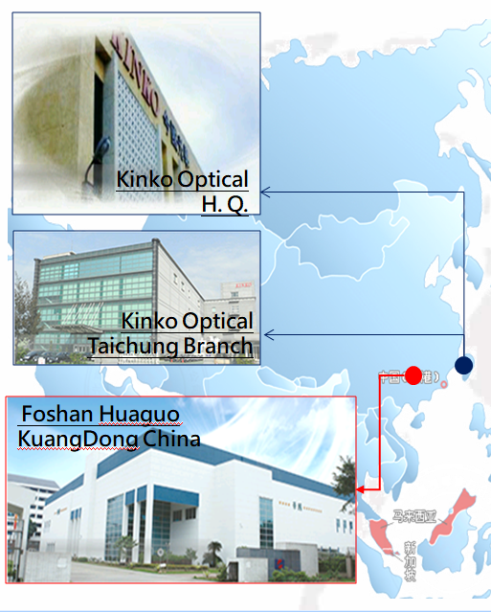
Company Profile
Kinko Optical CO., Ltd.
今國光學工業股份有限公司
Established: | 19th June 1980
Founder/C.E.O. | Mr. Chen, Ching-Chi (Kent)
GM: | Mr. Chen, Yi-Fang (Jason)
Registered capital: | Approx: NTD 1.74 Billion
Main business units: | Glass Lens / Molding Glass Lens / Lens units /Optical Lens design & manufacture
Numbers of Employee: | 1,698 people
H.Q.: | Kinko Optical (Taichung Taiwan)
Factories: | Kinko Optical (Taichung Taiwan)
 | Foshan HuaGuo (GuangDong China)

Slide 5
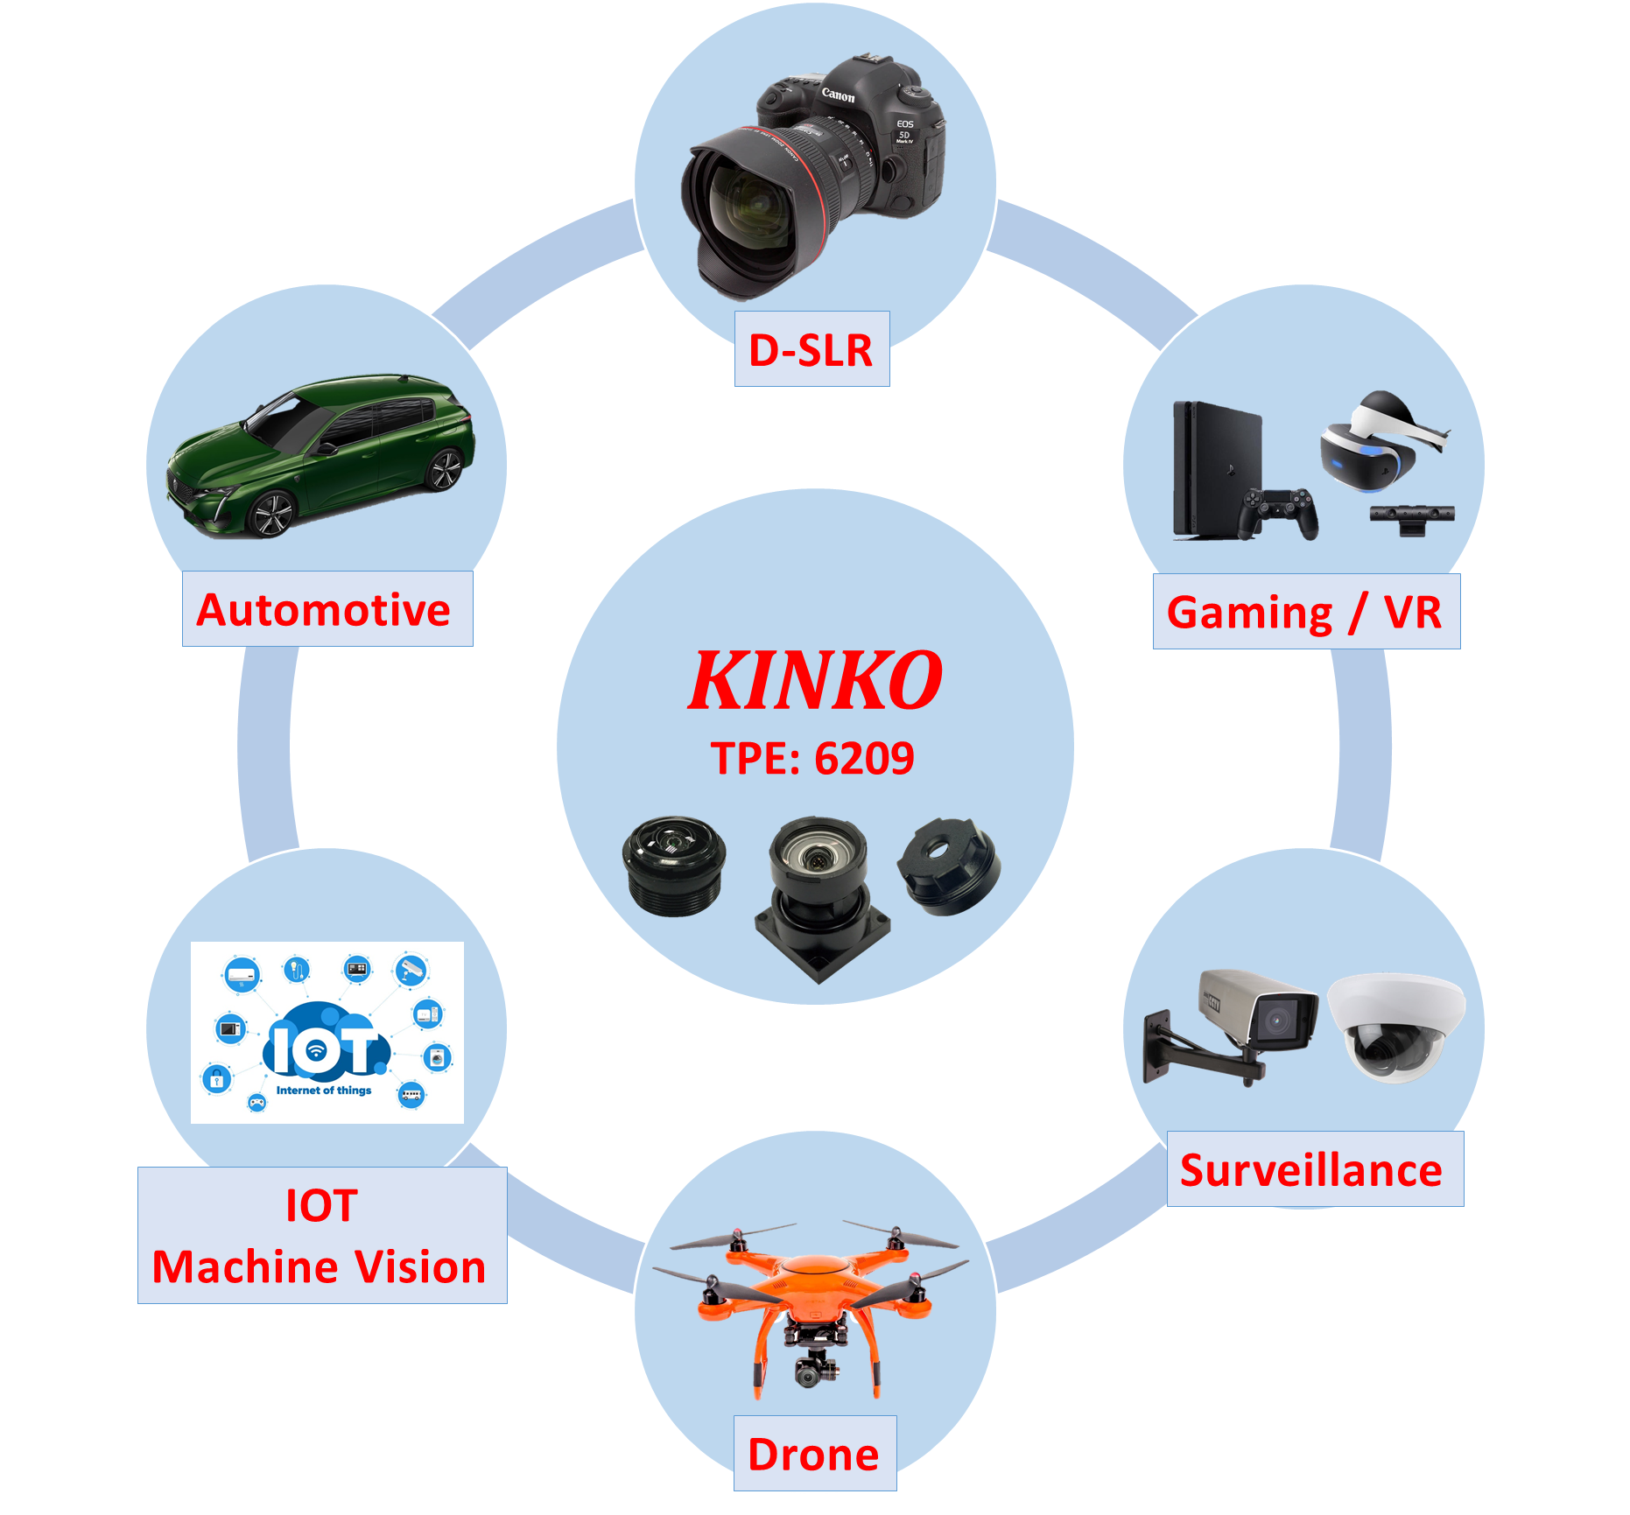
Strength of KINKO
Nearly 43 years experience with glass polished lens, 20 years with molding glass and 17 years with lens units.
Professional and experienced R&D members could perform outstanding techniques.
Cooperate with top-notch companies in different industries.
Sophisticated business culture --- Kinko’s Core value “faith, integrity and selflessness”.

Slide 6


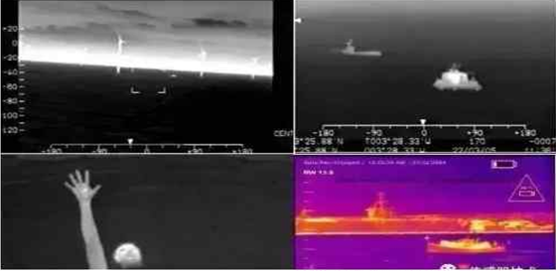
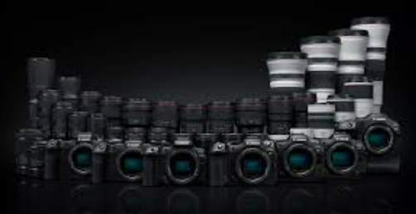
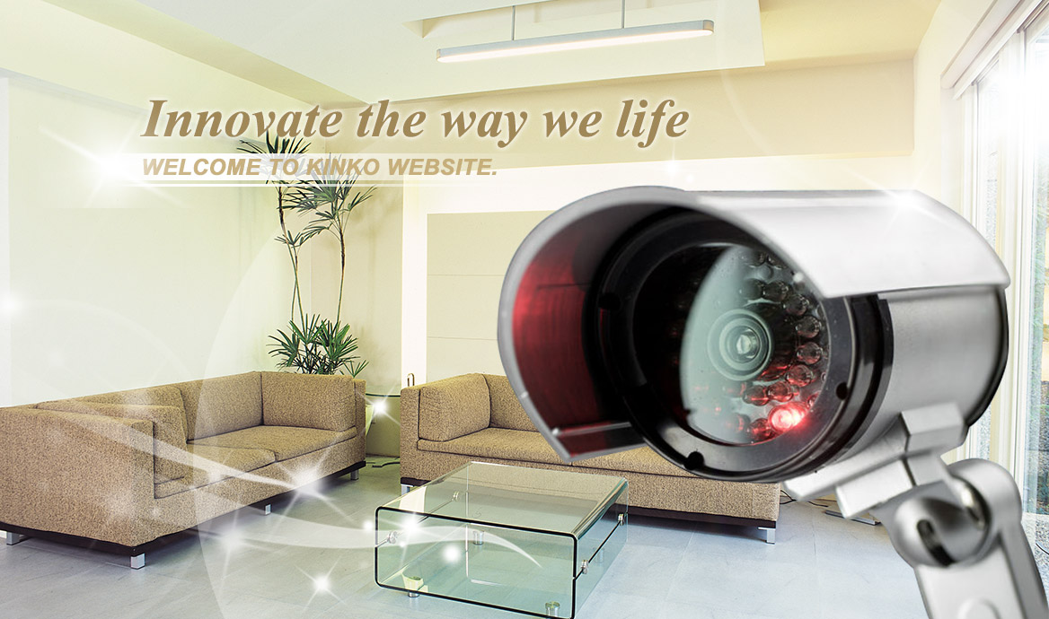
Product Development
IOT lens
Automotive lens
Infrared Thermal Imaging Lens
DSLR Lens
Doorbell
Indoor/ Outdoor
Facial Recognition
Smart Speaker
Smart Warehouse
Rear View
In-Cabin Monitoring
ADAS
Surround View
Infrared Thermal Imaging
Security
Automotive
Medical
Industrial
High Precision
Laminated lens

Slide 7
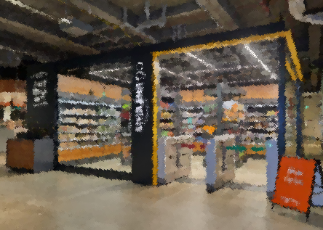
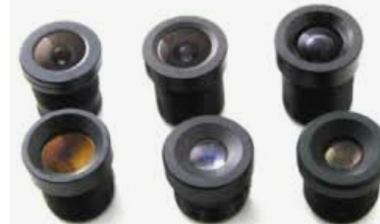
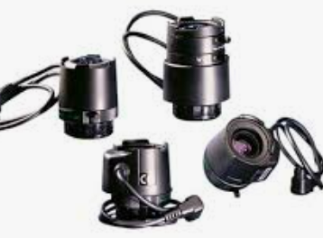
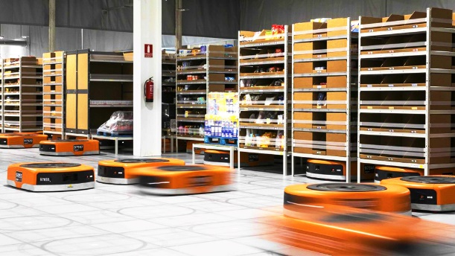
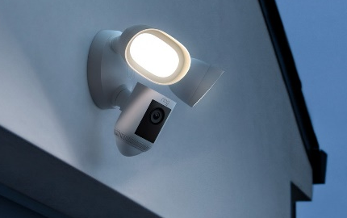
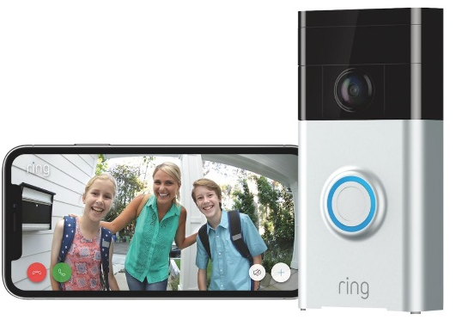
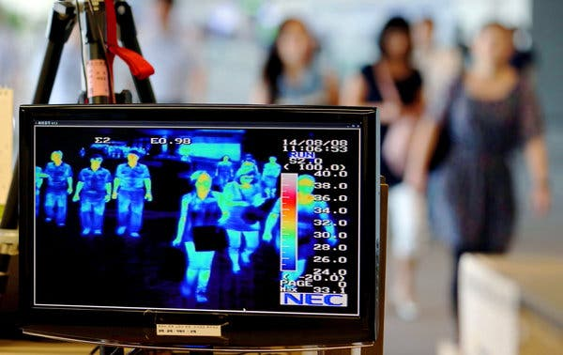
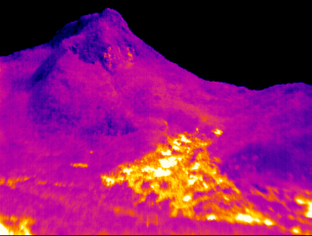
IOT Lens
Retail
Commercial
Surveillance
Self-service Store/ Smart Warehouse
Smart Building
Consumer
Smart Doorbell
Indoor/ Outdoor
Smart Home
Smart City
Infrared
Government
Airport, Port

Slide 8
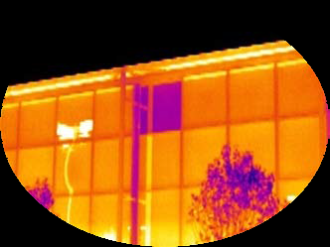
Infrared Thermal Imaging Lens
Medical
Building
Electricity
Automotive
After several years of development, we started to ship out our first infrared thermal imaging lens starting from Y2020. By September 2023, it is taken up 12.5% of our sales revenue. It has been widely used in a variety of product application.

Slide 9
Product Ratio By Revenue
 | Y2021 | Y2022 | Y2023 Jan-Sep
IOT | 30.10% | 32.59% | 37.70%
Automotive/Lens Element | 11.60% | 9.42% | 11.00%
DSLR | 31.10% | 29.35% | 24.10%
LWIR Lens | 13.10% | 17.05% | 12.50%
Other | 14.10% | 11.59% | 14.70%

Slide 10
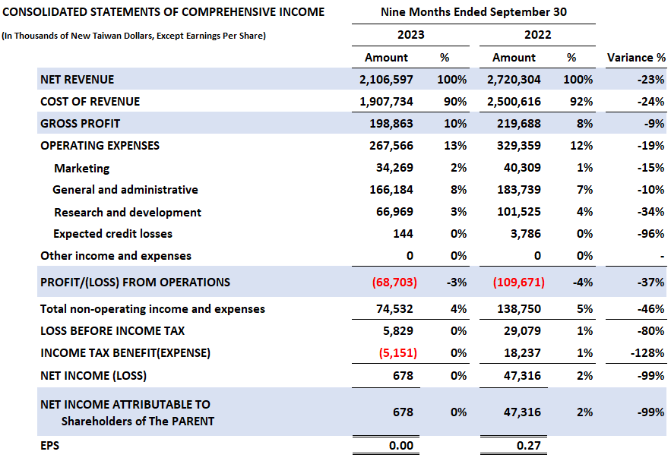
Financial Report

Slide 11


KINKO’s Vision
Become top-notch supplier for Hybrid lens (Glass + Plastic).
Become one of the major global suppliers of high-end and mainstream IOT products.
Become one of the main supplier in automotive industry globally.
Become one of the leading infrared thermal imaging lens suppliers in the Blue Ocean market

Slide 12
Thank you!

