Slide 1
Institutional investors
SUCCESS
OPTICAL
今國光學工業股份有限公司
Kinko Optical CO.,Ltd / Stock number: 6209
KINKO
OF
THE
21th Nov. 2019

Slide 2
CONTENT
Innovate the way we live. Make the life better.
Disclaimer
Product Ratio
01
05
02
Company Profile
06
Core Value
Strength of Kinko
07
Financial Report
03
Product Development
08
Kinko’s Vision
04

Slide 3
DISCLAIMER
Innovate the way we live. Make the life better.
The information contained in this presentation, including all forward-looking information, it subjects to change without notice, whether as a result of new updates, further events or otherwise, and Kinko Optical Co., Ld undertakes no obligation to publicly update or revise the information contained in this presentation
Investors should not regard the above forward-looking information as legally binding but as information subject to change. No guarantees regarding the completeness, accuracy, and reliability of information contained are made explicitly or implicitly. They are not intended to represent complete statement of the Company, industry or future development.
KINKO
OPTICAL
Disclaimer

Slide 4
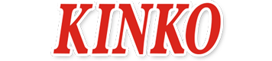
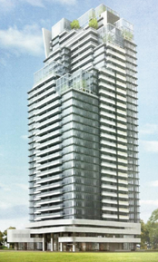
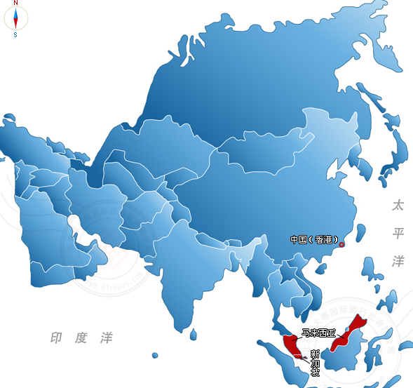
Company Profile
Innovate the way we live. Make the life better.
Kinko Optical Co., Ltd
Established: | 19th June 1980
Founder/C.E.O. | Mr. Chen, Ching-Chi (Kent)
GM: | Mr. Chou, Liang-Chang
Registered capital: | Approx: NTD1.63 trillion
Main business units: | Glass Lens / Molding Glass Lens / Lens units /Optical Lens design & manufacture
Numbers of Employee: | 2,740 people
H.Q.: | Kinko Optical (Taichung Taiwan)
Factories: | Kinko Optical (Taichung Taiwan)
 | Foshan HuaGuo (GuangDong China)
Offices: | R&D Center (Taichung Taiwan)
Kinko Optical
H. Q.
Kinko Optical
R&D Center
Kinko Optical
Taichung Harbor Branch
Foshan Huaguo
KuangDong China

Slide 5
Strength of Kinko
KINKO
OPTICAL
Nearly 40 years experience with glass polished lens, 15 years with molding glass and 12 years with lens units
Processional and experienced R&D members could perform outstanding techniques.
Corporate with top-notch companies in different industries
Sophisticated business culture --- Kinko’s Core value “faith, integrity and selflessness”.

Slide 6
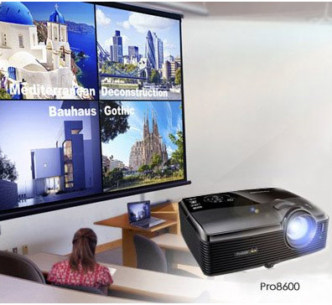
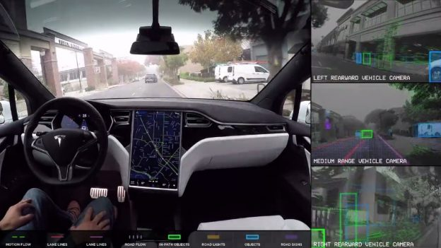
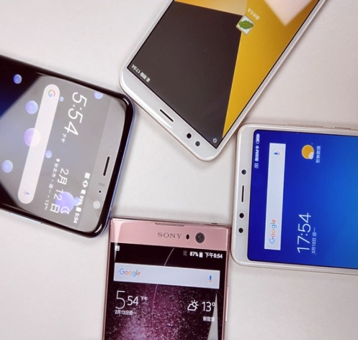
Product Development
Innovate the way we live. Make the life better.
IOT lens
Projector lens
Automotive lens
Gaming lens
Mobile lens
Doorbell
Indoor/ Outdoor
Facial Recognition
4K projector
Gaming projector
Rear View
ADAS
Surround View
NIR
Gaming
AR/ VR, wide angle lens
High resolution
Dual- camera
3D sensing

Slide 7
Product Ratio
Innovate the way we live. Make the life better.
 | 2018 | 2019(Q1~Q3)
DSLR (Single Lens) | 56.5% | 43.9%
IOT Lens | 12.2% | 20.4%
Projector Lens | 5.7% | 9.1%
Automotive Lens | 8.7% | 8.1%
Mobile/ Gaming Lens | 4.9% | 5.0%
Inspection Lens | 0.0% | 3.4%
Industrial Lens | 2.9% | 2.6%
Medical Lens | 1.9% | 1.6%
Telescope | 2.0% | 1.4%
Others | 5.2% | 4.5%

Slide 8
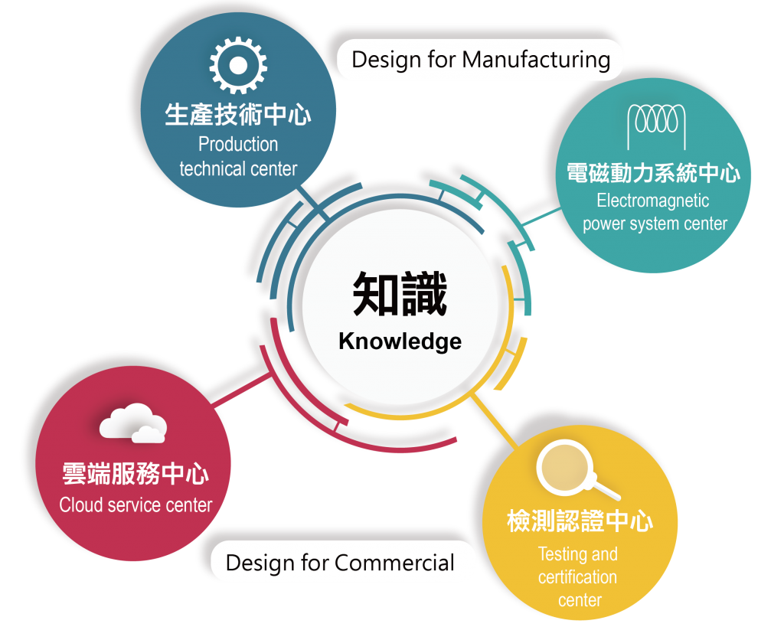
Core Value
Innovate the way we live. Make the life better.
Innovation
Quality
KINKO
Core Value
Customer
Satisfaction
Speed

Slide 9
Financial Report
Management Performance --- Annual Comparison
Consolidated (2018Q3) |  | 2018 Q1~Q3 |  |  | 2019 Q1~Q3 |  |  | Annual Growth
Unit: In thousands of NT$ |  | Amount | % |  | Amount | % |  | %
Sales Revenue |  | 2,691,373 | 100.0% |  | 2,545,940 | 100.0% |  | -5.4%
Operating Costs |  | 2,556,987 | 95.0% |  | 2,428,694 | 95.4% |  | -5.0%
Net Operating Margin |  | 134,386 | 5.0% |  | 117,246 | 4.6% |  | -12.8%
Total Operating Expenses |  | 290,374 | 10.8% |  | 303,216 | 11.9% |  | 4.4%
Selling Expenses |  | 27,107 | 1.0% |  | 25,844 | 1.0% |  | -4.7%
Administrative Expenses |  | 183,340 | 6.8% |  | 179,848 | 7.1% |  | -1.9%
Research and Development Expenses |  | 79,927 | 3.0% |  | 97,524 | 3.8% |  | 22.0%
Operating Profit (Loss) |  | (155,988) | -5.8% |  | (185,970) | -7.3% |  | 19.2%
Non- operating Income and Expenses |  | 50,371 | 1.9% |  | 55,117 | 2.2% |  | 9.4%
Profit (Loss) Before Income Tax |  | (105,617) | -3.9% |  | (130,853) | -5.1% |  | 23.9%
Income Tax (Expense) Benefit |  | 16,767 | 0.6% |  | 11,959 | 0.5% |  | -28.7%
Continuing Operations’ Income(Loss) Before Tax |  | (88,850) | -3.3% |  | (118,894) | -4.7% |  | 33.8%
Income (Loss) from Discontinued Operations |  | 118,699 | 4.4% |  | 0 | 0.0% |  | -100.0%
Profit (Loss) for the year |  | 29,849 | 1.1% |  | (118,894) | -4.7% |  | -498.3%
Profit (Loss) attributable to owners of the Parent |  | (20,896) | -0.8% |  | (115,868) | -4.6% |  | 454.5%
EPS |  | (0.13) |  |  | (0.71)

Slide 10
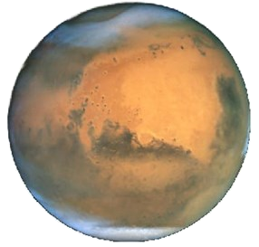
KINKO’s VISION
Innovate the way we live. Make the life better.
Become top-notch supplier for Hybrid lens (Glass + Plastic)
Become one of the main supplier in IOT industry globally
Become one of the main supplier in automotive industry globally
Expand market into first class mobile phone company in the world

Slide 11
Thank you for your attention!
部分圖片引用網路

